Slide 1

Brunner International SLC500 Level 1 Training Program

Slide 2
Why a Level 1 Course?
Why a Level 1 Connection Techniques course?
This course was designed to address the issues Electricians typically experience while working with the Rockwell Automation SLC500 products.
7 Key Issues are intended to be addressed in this course.

Slide 3
7 Key Issues Addressed
Cannot go On-Line.
What Cables do I need?
Which Software do I use?
What is RS-Linx and how do I configure it?
Where are the Comments and Symbols?
How do I Upload and Download?
The Bits and Word Addresses are different than the documentation.

Slide 4
7 Key Issues
The intent of the course is to give a basic understanding of connection techniques as well as provide technical resolution to the 7 listed key issues.
During and at completion of this course, students are encouraged to ask questions and indicate areas where more content or help may be needed.

Slide 5
Course Outline

Slide 6
Introduction
Course length 5 days 4 hours per day.
30 minute break at approximately 2 hours.

Slide 7
Course Itinerary
Level 1 Schedule
 | Mon | Tues | Wed | Thurs | Fri | Students
8am-12am | 4 hrs | 4 hrs | 4 hrs | 4 hrs | 4 hrs | 2 Electricians
1pm-5pm | 4 hrs | 4 hrs | 4 hrs | 4 hrs | 4 hrs | 2 Electricians
Level 2 Schedule
 | Mon | Tues | Wed | Thurs | Fri | Students
8am-12am | 4 hrs | 4 hrs | 4 hrs | 4 hrs | 4 hrs | 2 Electricians
1pm-5pm | 4 hrs | 4 hrs | 4 hrs | 4 hrs | 4 hrs | 2 Electricians
Level 3 Schedule
 | Mon | Tues | Wed | Students
8am-12am | 4 hrs | 4 hrs | 4 hrs | 1 Programmer
1pm-5pm | 4 hrs | 4 hrs | 4 hrs | 1 Programmer

Slide 8
Terminology
RIO (Remote Input/Output)
A Rockwell Automation Communication system utilizing High Speed Serial Communication. (57.6 and 230.4 KB) Commonly called “Blue Hose”.
Transfers information to and from remotely mounted devices to the SLC-500.

Slide 9
Terminology
Serial
Or “RS-232” is a 3 conductor point to point connection.

Slide 10
Terminology
DH+
Data Highway + is a Rockwell Automation designed network that allows multiple processors to communicate with each other.
The connection also allows you to communicate to any of the processors connected to the DH+ network.
Also referred to as “ Blue Hose”
Resembles RIO Network.

Slide 11
Terminology
Node Address
A node address is a unique number assigned to each SLC-500 or PLC-5 processor on the DH+ network.
In an SLC-500 this is assigned in the Channel configuration/Chan 1-system area of the software.
On a PLC-5 this is assigned via DIP switches
There can only be 1 device on the network with that unique number.
On a DH+ system you may have up to 64 unique devices connected. (0 to 63 Decimal)
The nodes are addressed in octal from 0 to 77 Octal.

Slide 12
Typical Network Configuration

Slide 13
Upload / Download
Upload
Means to retrieve the program that is currently in the SLC-500 to the PC.
Download
Means to send the currently open ladder project file from the PC to the SLC-500.

Slide 14
RS-Linx
What is RS-Linx?
RS-linx is a Software communication program developed by Rockwell Automation which is required to allow communication with various Rockwell Automation products.
It is used to LINK together Rockwell Automation Software and various RA hardware.
The LINKS or Configured Drivers are set up in RS-Linx.

Slide 15
RS-Linx
The two Basic Configured Drivers that are required for the vast majority of applications at Brunner are DH+ and Serial or RS-232. (others are available)
DH+ is the most common.
Each requires a different communication cable and configuration of the Driver.
Once set, you normally will not need to change anything else with the Driver configuration.

Slide 16
RS-Linx DH+ Configuration Hands on Demonstration
(Optional) Instructor Walkthrough of a typical DH+ Configuration
Student Objectives:
Create a DH+ Driver (Page 1 of Connections manual)
Go On line to a SLC-5/04 processor (Page 12 of Connections manual)

Slide 17
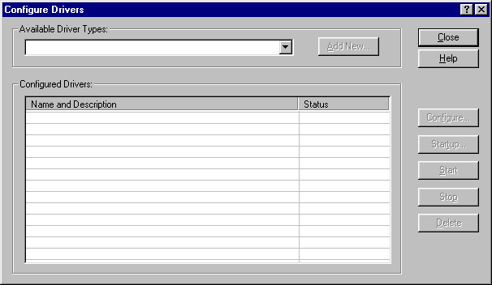
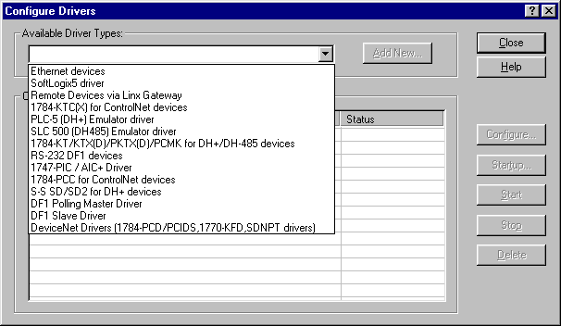
Configuring the DH+ RS-Linx Driver
A
B
Open RS-Linx.
Go to COMMUNICATIONS at the top of the Toolbar.
Click on COMMUNICATIONS, then click on CONFIGURE DRIVERS.
Click on the Pull down arrow labeled A in the diagram above
Click on the selection labeled B in the above diagram.
Click on ADD NEW.

Slide 18
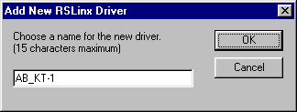
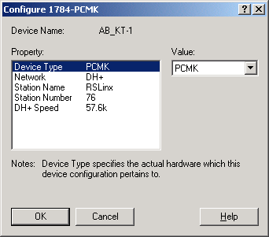
Configuring the DH+ RS-Linx Driver Cont.
D
C
Click on OK in the above diagram.
From the property area click on DEVICE TYPE labeled C.
Go to VALUE and Click on the Pull Down window labeled D.
From the Pull down list, click on PCMK.
Go to the next Property, which is NETWORK and click on it.
Go to VALUE and click on the Pull Down window to select DH+.
Go to the next Property, which is STATION NAME and click on it.
Leave the STATION NAME as RSLinx.
Go to the next Property, which is STATION NUMBER and click on it.
Go to Value and type in a Station Number to use for your computer.
(Recommended values are a number between 70 to 76)

Slide 19

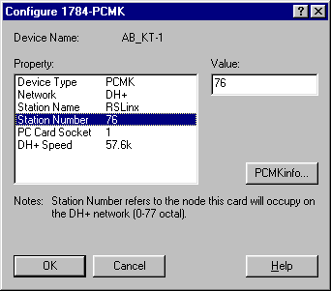
Configuring the DH+ RS-Linx Driver Cont.
The RS-Linx DH+ Driver is now configured!

Slide 20
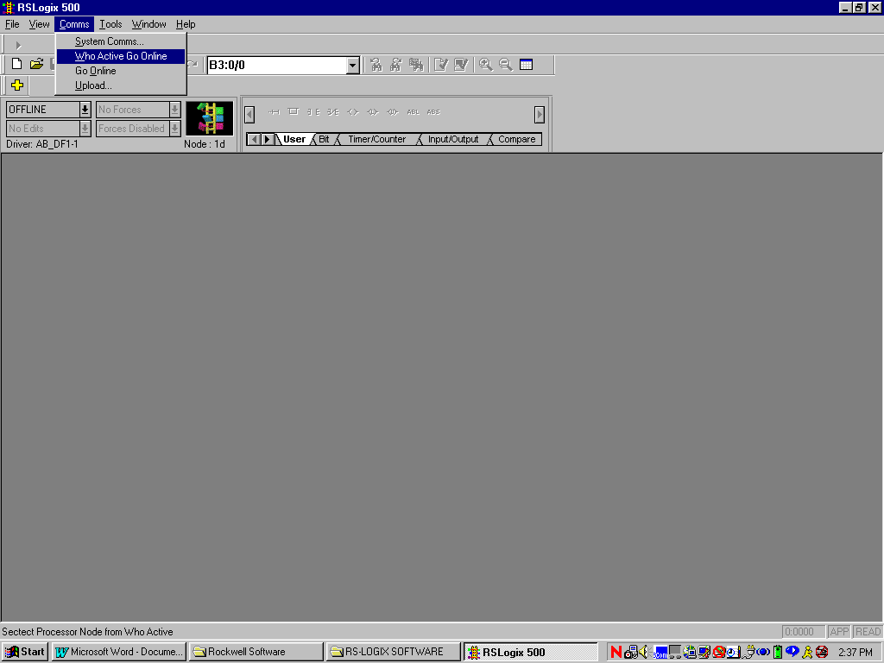
Online Connection to SLC Via DH+
ON LINE CONNECTION TO A SLC PROCESSOR VIA DH+
THIS IS THE MINIMUM REQUIRED TO CONNECT TO A DATA HIGHWAY NETWORK.
THIS WILL NOT GIVE YOU THE COMMENTS AND DESCRIPTORS, JUST THE LADDER LOGIC.
Before starting ensure that this is indeed a Data Highway connection.
This can be determined by looking at the front of the SLC-500.
The DH+ connector is the small 8 pin DIN connector.
The SLC-500 Cable (Cat # 1784-PCM5) will connect from this 8 pin connector to the PCMK card in your computer.
You will also need to have the AB-KT1 DH+ RS-Linx driver configured in RS-Linx.
IF the above steps are not correct, YOU will not be able to communicate to a processor.
Open the RS-Logix 500 software.
Use the mouse to CLICK on Comms then CLICK on Who Active Go Online as per the Illustration below:

Slide 21
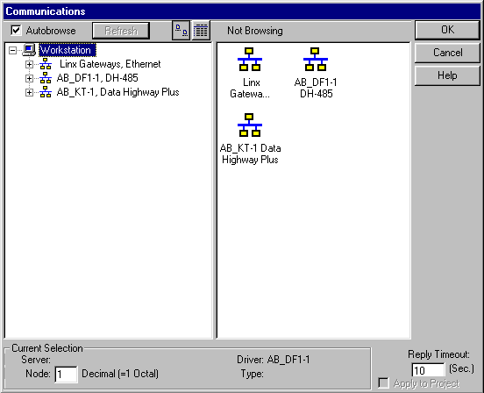
Online Connection to SLC Via DH+ Cont
THE DH+ LIGHT ON THE SLC 500 PROCESSOR SHOULD ALSO BE ON SOLID GREEN.
If the LED is not solid green the DH+ baud rate on the processor is different than the RS-Linx DH+ driver configuration.
The above Illustration is the RS-Linx communication screen.
This is the screen from which you will select one of the RS-Linx drivers.
That RS-Linx driver in turn will show you the processors that are on line.
IF THE AB_KT1 DATA HIGHWAY PLUS Linx driver does not appear you may not have it configured in RS-Linx or you may have Stopped. You would then need to go to RS-Linx and either start it or add it to the list of configured drivers.
Since we are using DH+ you will CLICK on the AB-KT1 Data Highway Plus area as shown below:

Slide 22
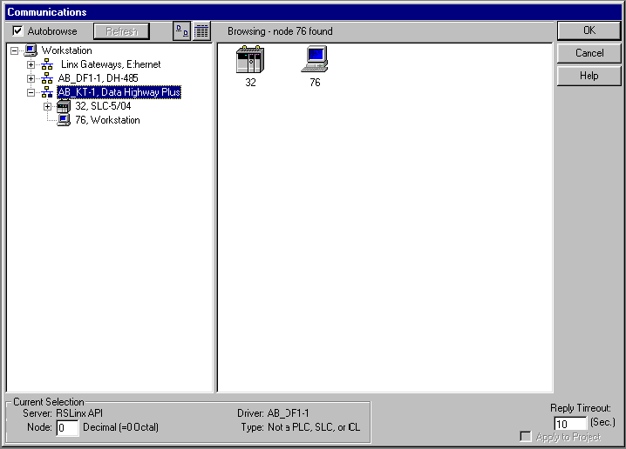
Online Connection to SLC Via DH+ Cont
Upon clicking your mouse on this driver the active processors on the DH+ network will be displayed.
You will also see a computer icon, which is your computer on the DH+ network.
If you see any stations with Red X”S through them, this means those stations are not on the DH+ network you are currently connected to.
You must now determine (if more than one processor is showing) which processor you want to talk to.
You can determine this by looking at the name of the processor on the screen.
The name may contain the Brass Tag or PEE number to identify the processor.
Use your mouse to CLICK on the processor you want to communicate to.Then CLICK your mouse on OK in the upper right hand corner of the window.

Slide 23
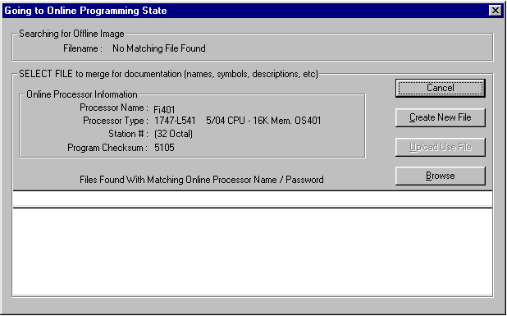
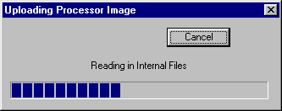
Online Connection to SLC Via DH+ Cont
Use your mouse to Click on Create New File.
The screen below will appear.
Shortly after that another screen will appear briefly saying “Add Default Description Record”
You will now go on-line and the Ladder Logic will appear.
The picture of the ladder will be rotating on the RS-Logix 500 Window indicating to you that you are now on line.
You will not have the comments and descriptors, but you can now use the Ladder Logic manuals provided to find the corresponding descriptions.

Slide 24
RS-Logix 500 Navigation Demo
Instructor Objective:
Walk Thru and Explain the basic layout of the Project Tree within RS-Logix 500

Slide 25
END OF DAY 1

Slide 26
DAY 2

Slide 27
Day 1 Review
Review and questions from Day 1
Terminology
RIO/Serial/DH+
Node Address
SLC
PLC5
What is Upload /Download?
RS Linx
Creating DH+ Driver
Project Tree Layout

Slide 28
Serial / RS-232
DH+ is the preferred method of communication with an SLC-500.
Times when this is not an option:
The 1784-PCM5/B cable is missing or Bad.
The 1784-CP7 attachment is missing.
The 1784-PCMK card is not in the computer or missing.
You are performing a replacement with an SLC-500 out of the box.
You are unsure which processor to connect to due to limited project file documentation.

Slide 29
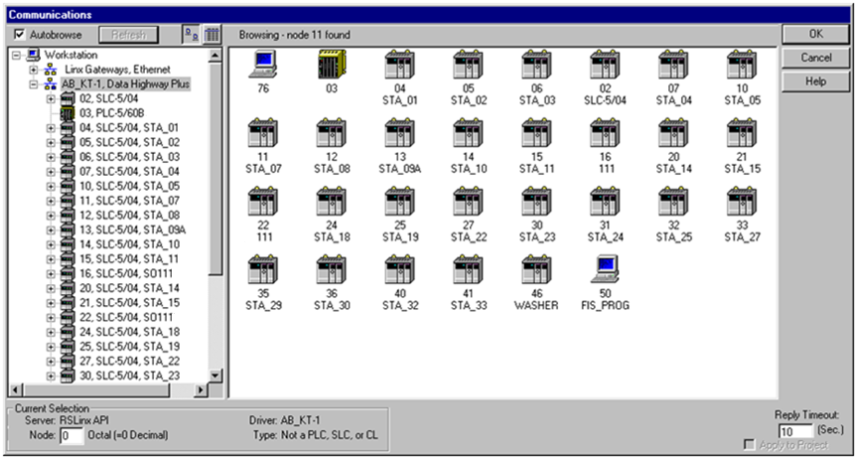
Typical Network with GOOD SLC-500 Name Documentation

Slide 30
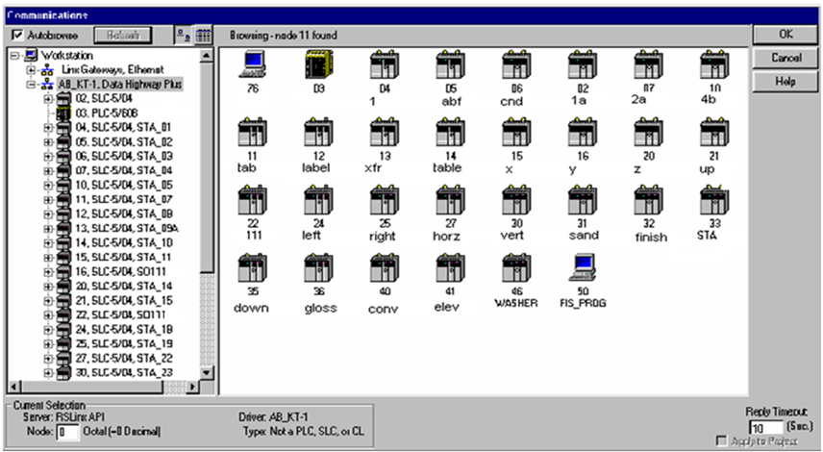
The same Network with BAD SLC-500 Name Documentation

Slide 31
Serial / RS-232
The Serial Connection method will help in the BAD illustration.
The Serial Connection only displays and connects to the SLC-500 Processor that you have you cable connected to.
You are not burdened with all the SLC-500 processors being displayed.

Slide 32
RS-Linx Serial Driver Configuration Demonstration
(Optional) Instructor Walk Through a typical RS-232 Configuration
Student Objective:
Create an RS-232 Driver (Page 4 of Connections Manual)
Go On line to a SLC-5/04 processor (Page 8 of Connections Manual)

Slide 33
Configuring the RS-232 RS-Linx Driver
1
2
Open RS-Linx.
Go to COMMUNICATIONS at the top of the Toolbar.
Click on COMMUNICATIONS, then click on CONFIGURE DRIVERS.
Your display may show drivers that have been configured previously.
Click on the Pull Down arrow labeled 1 in the diagram above.
Click on the selection labeled 2 in the figure above.
Click on ADD NEW.

Slide 34
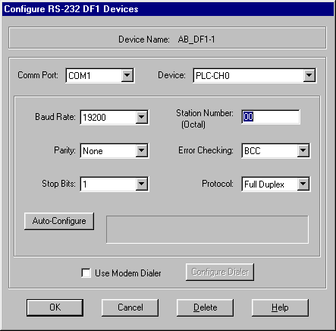

Configuring the RS-232 RS-Linx Driver Cont.
3
AT THIS POINT YOU HAVE 2 OPTIONS
YOU MAY PERFORM AN AUTOCONFIGURE ONLINE, IF YOU HAVE THE RS-232 CABLE CONNECTED TO THE PROCESSOR.
YOU MAY CONFIGURE THE DRIVER OFFLINE
TO AUTOCONFIGURE ON LINE, PERFORM THE FOLLOWING:
Click on the AUTO-CONFIGURE window labeled 3 in the above figure.
RS-Linx will go out on line and configure the driver automatically for you.
If the autoconfigure worked properly the message AUTO CONFIGURATION SUCCESSFUL will appear.
You are now ready to use the RS-232 Driver in RS-Logix.
You may now exit out of RS-Linx and begin using the RS-Logix software.

Slide 35
Online Connection to SLC (RS-232)
ON LINE CONNECTION TO A SLC PROCESSOR VIA THE RS-232 PORT
THIS WILL NOT GIVE YOU THE COMMENTS AND DESCRIPTORS, JUST THE LADDER LOGIC.
When you connect via RS-232 you are connecting directly to one processor only.
Before starting ensure that this is indeed an RS-232 connection.
This can be determined by looking at the front of the SLC-500.
The RS-232 connection is the 9 pin connector on the SLC-500 processor module.
The SLC-500 Cable (Cat # 1747-CP3) will connect from this 9 pin connector to the 9 pin Com port on your computer.
You will also need to have the AB-DF1 DH-485 RS-Linx driver configured in RS-Linx.
IF the above steps are not correct, YOU will not be able to communicate to a processor.
Open the RS-Logix 500 software.
Use the mouse to CLICK on Comms then CLICK on Who Active Go Online

Slide 36
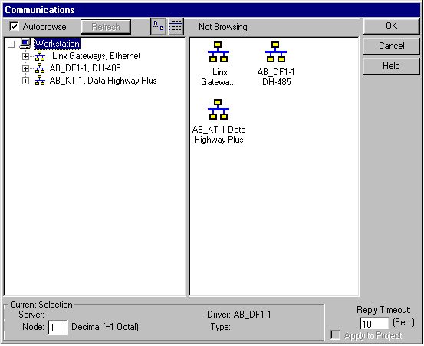
Online Connection to SLC (RS-232) Cont.
Illustration is the RS-Linx communication screen.
This is the screen from which you will select one of the RS-Linx drivers.
That RS-Linx driver in turn will show you the on line processor.
IF THE AB-DF1 DH-485 Linx driver does not appear you may not have it configured in RS-Linx or you may have it Stopped. You will then need to go to RS-Linx and either start it or add it to the list of configured drivers.
Since we are using RS-232 communication use your mouse to CLICK on the AB-DF1 DH-485 area as shown:

Slide 37
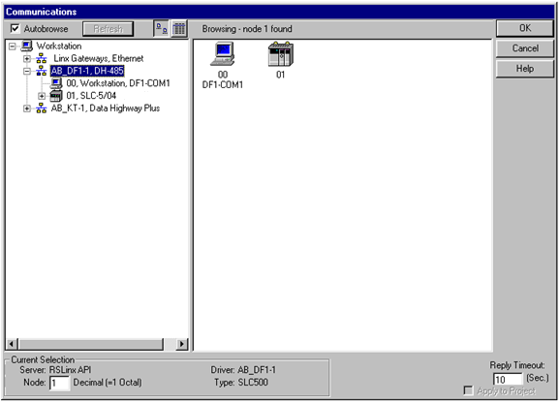
Online Connection to SLC (RS-232) Cont.
Upon clicking your mouse on this driver the active processor on the AB-DF1 DH-485 network will be displayed.
You will also see a computer icon, which is your computer on the AB-DF1 DH-485 network.
If you see any stations with Red X”S through them, this means that those stations are not on the network you are currently connected to.
Use your mouse to CLICK on the processor you want to communicate to. Then CLICK your mouse on OK in the upper right hand corner of the window.
The next screen to come up will be as follows:

Slide 38
Online Connection to SLC (RS-232) Cont.
You will now go on-line and the Ladder Logic will appear.
The picture of the ladder will be rotating on the RS-Logix 500 Window, indicating that you are now on-line.
You will not have the comments and descriptors, but you can now use the Ladder Logic manuals provided to find the corresponding descriptions.
Use your mouse to Click on Create New File

Slide 39
RS-Linx Drivers
There are several RS-Linx Driver configurations that are available.
The Han Tek Main Control has the option to use the Ethernet Driver.
A copy of the procedure to configure this Driver (RS Linx DH+, RS-232) will be given to you by your instructor.

Slide 40
Connection Exercises
Objectives:
DH+
Create and configure DH+ driver.
Establish online connection with the SLC 5/04 processor.
RS-232
Create and configure RS-232 driver.
Establish online connection with the SLC 5/04 processor.
Notes:
Proc #1 troubleshooting:
Open RS-Logix 500.
Open program BT603178
When the students attempt to download the program, the error “No response from processor at the selected path/node” will be displayed.
To correct this problem the node address will need to be changed temporarily to correspond to the processor in the rack (the address is 5)
To determine the node address you must do a WHO ACTIVE .
Once you know the node address, go offline and in controller properties/ controller communications, change the processor node address to 5.
Click on OK, then apply.
Now do a download.
ONE WAY TO SETERMINE WHICH PROCESSOR IS WHICH IS TO PULL THE DH+ CONNECTORS FROM THE PROCESSORS ONE AT A TIME.
After the students have completed the exercise, I will need to download the original program (BT603178 with a node address of 32) back into the processor for the next class.

Slide 41
Comments and Symbols
What are Comments and Symbols?
Comments and Symbols or Descriptors are text that is used to describe various rungs of ladder logic or individual inputs and outputs.
They are created by the programmer who developed the ladder logic.
They do not reside in the SLC-500 processor, but on your computer in a project file with an extension of .RSS.
If the .RSS file you have does not contain them, you will only display the ladder logic.
To display Comments and Symbols you must either have them on a floppy disk, or on your computer.

Slide 42
Project file Extension
All ladder logic project files are stored with the following extensions:
SLC-500 example Project file: BT123.RSS.
BT123 is the Project file name.
.RSS is the extension and stands for Rockwell Software SLC.

Slide 43
SLC-500 Back up File
SLC-500 example Back up File: BT123_Bak01.RSS.
BT123 is the project file name.
_Bak01 designates a backed up file.
A back up version of a project file is created anytime a project is saved or closed.
The HIGHER the number, the more recent the backup.

Slide 44
PLC-5 Extension
A PLC-5 project is stored very similar.
PLC-5 example Project file: BT123.RSP.
BT123 is the project file name.
.RSP is the extension and stands for Rockwell Software PLC.

Slide 45
PLC-5 Back up
PLC-5 Back up example Project file: BT123_Bak01.RSP.
BT123 is the project file name.
_Bak01 designates a backed up file.
A back up version of a project file is created anytime a project is saved or closed.
The HIGHER the number, the more recent the backup.

Slide 46
Floppy Disk with Comments and Symbols
For most machines on the plant floor a copy of the most recent ladder logic with the Comments and Symbols should be available.

Slide 47
Comments and Symbols
In Day 3 we will go over how to retrieve the Comments and Symbols.

Slide 48
END OF DAY 2

Slide 49
DAY 3

Slide 50
Review
Review and questions from Day 2
Processor Naming Structure (Good vs Bad)
Download file into Demo SLC
Using Serial Connection
Using DH+ Connection
Comments and Symbols
Project file extension (SLC 500)
Saved from online session
Back-up file
Project file extension (PLC 5)
Saved from online session
Back-up file
Storage of most recent program file

Slide 51
Comments and Symbols
The preferred method to retrieve or merge the Comments and Symbols to your program is to:
Copy or Drag and Drop the .RSS file with the comments and symbols from a floppy to your computer.
Run the file directly from your computer as the file now resides on your computer.

Slide 52
Comments and Symbols
2 other methods can be used but they can create additional problems:
Perform an Ascii or Native Import.
This method can be used but this method does not import the ladder program file names.
Run the program directly from the floppy disk.
This can cause A: drive read errors if you remove the floppy before completely shutting down RS-Logix 500.

Slide 53
Comments and Symbols
We will concentrate our efforts to the first method.
Student Objective:
Copy the program “CNCTS” given to you by your instructor unto your hard drive.
Open the program to verify Comments and Symbols are available.
Download the program to the Trainer.
When you go on line you will now have the Comments and Symbols.

Slide 54
Comments and Symbols
You may experience an instance when you go online to a processor and the Comments and Symbols come up automatically without you having to copy the program to your hard drive.
The reason for this is in the way RS-logix searches for programs on your hard drive.

Slide 55
Comments and Symbols
RS-Logix Does not search using the (Proc Name) .RSS nomenclature.
RS-Logix searches into the .RSS file for the Controller Properties, Processor name and Checksum number.
A typical example of this follows:

Slide 56
Comments and Symbols
Scenario:
You have saved the same program 5 times but with a different name each time.
The program was not modified during any of those 5 saves.
In this case they were saved as follows:
test1.rss, test2.rss, test3.rss, test4.rss, and test5.rss.
Each has a controller properties name within the .RSS file as “DEMO”.
When you perform a Who Active Go on line , RS-Logix first searches for all the .rss files with an internal Controller Properties name of “DEMO”.

Slide 57
Comments and Symbols
In this case it will find 5 of them.
RS-Logix will now examine the internal Checksum value on the Controller Properties screen of each program and compare it to the checksum value currently in the SLC-5/04 you are connected to.
If there is a match, that is the program that is opened.
If more than 1 program has the same Checksum value, RS-Logix determines which one it will open.
RS-Logix will only open the file if the Controller Properties and Checksum value are the same.

Slide 58
Comments and Symbols
If there is no match to any of them, the Create New File/Browse Screen will appear.
You now become responsible for picking which of the 5 programs you want to download.
Note: The program you pick may not necessarily be the most current version.
The only time the Checksum number will change is when you modify and save the program.

Slide 59
SLC Out of the Box
What is SLC Out of the Box?
SLC Out of the Box is a SLC 500 processor that is being used for the very first time.
It is not a processor that has been used at one time and then put on the shelf.
It is a Processor from the factory still in the Anti Static Bag.
The processor is factory defaulted to Node address 1.
In a single stand alone application this does not pose a major problem, but machine with multiple stations with processors, this Node address may cause a conflict.
Notes:
Draw on the board there computer with node address 76 and connected to 5 processors with node addresses 1 thru 5.
Replace node 3 with the OUT OF THE BOX processor, noting that this processor will now become node address 1 as well, causing a conflict with the other node address 1 processor.
A couple of ways around this would be to disconnect the Blue hose so there is no conflict and also you could load in the program using RS-232 communications.

Slide 60
SLC Out of the Box Lab
Student Objective:
Perform the Out of the Box procedure (Page 35 of the connections manual).
Remove the SLC-5/04 processor from the Trainer.
Install the new SLC-5/04 processor into the Trainer.
Using the procedure from page 35 of the connections Techniques Manual, perform a download of the program.
Verify that the program did indeed download.
Remove the SLC-5/04 processor and reinstall the original processor.
Notes:
Draw on the board there computer with node address 76 and connected to 5 processors with node addresses 1 thru 5.
Replace node 3 with the OUT OF THE BOX processor, noting that this processor will now become node address 1 as well, causing a conflict with the other node address 1 processor.
A couple of ways around this would be to disconnect the Blue hose so there is no conflict and also you could load in the program using RS-232 communications.

Slide 61
SLC Out of the Box Procedure
PROCEDURE TO DOWNLOAD A SLC-500 PROGRAM TO A NEW SLC PROCEESOR JUST OUT OF THE BOX
NOTE:
A new processor out of the box will come as factory default to node address 1 and the DH + channel set to 57.6 KB.
Prior to performing this you should have a copy of the SLC-500 program you intend to download to the processor either stored on your computer or on a Floppy Disk.
Connect the 1784-PCM5/B cable from the 8-pin din connector of the SLC-500 processor to your PCMK card installed in the computer.
Open the RS-Logix 500 Software.
Use your mouse and CLICK on FILE OPEN.
Navigate to the file you want to download and DOUBLE CLICK on it.
The RS-Logix program file will open.
Use your mouse and go to COMMS, then WHO ACTIVE GO ON LINE.
This will bring up the RS-Linx communications Window.
Click on AB-KT DATA HIGHWAY PLUS.
The active nodes will be displayed.
You will find that Node 01 with the name Default will be displayed.
This tells you that the SLC-500 processor is active and has a Node Address of 01.
CLICK your mouse on CANCEL in the communications window screen to close this window.
You now must change the program file you have opened to be the same node address as the one you just installed.
In the Project Tree window Double Click your mouse on Controller Properties.

Slide 62
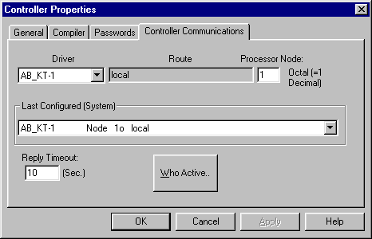
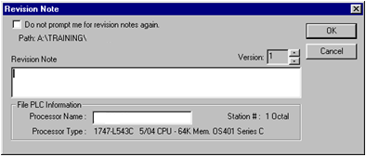
SLC Out of the Box Procedure Cont
Use the mouse and Click on Controller Communications.
The screen above should appear.
Type in 1 at the Processor Node area.
Use the Down arrow in the Last Configured (System) area to select Node 1.
YOUR COMPUTER SHOULD BE SET UP JUST LIKE THE ABOVE ILLUSTRATION.
Use your mouse and Click on Apply, then OK.
The screen should then close out and the node number on the RS-Logix screen will change to a 1.
(This number will be below the picture of the ladder with the colored blocks)
You now can go to COMMS and select Download.

Slide 63
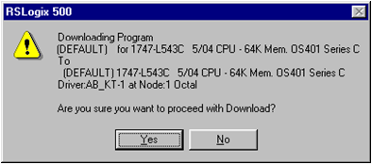
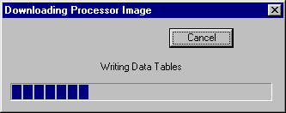
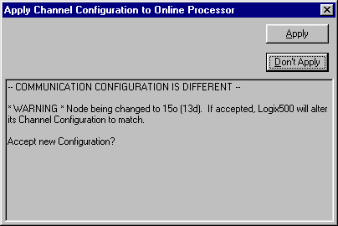
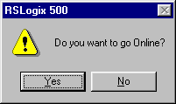
SLC Out of the Box Procedure Cont
The following screen may then come up depending on the type of processor you have replaced.
This screen is telling you that once the Ladder Logic file is downloaded, the Node Address will be changed to the value it had been assigned to in the Channel Configuration area of the program.
Click on APPLY.
RS-Logix will then download the processor image to the processor module.
The screen below will appear asking if you would like to go on line.

Slide 64
Micrologix 1200
A Micro SLC processor.
Requires a 1761-CBL-PM02/C cable to communicate to it.
RS-Linx Driver is configured for RS-232 Serial communications.
RS-Logix 500 Software is used to view the ladder logic.

Slide 65
Micrologix 1200 Online Lab
Student Objective:
Go on line to the Micrologix 1200.

Slide 66
SLC and PLC Addressing
SLC/PLC Scanner and Address handouts.

Slide 67
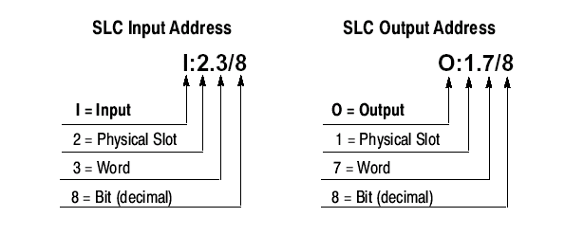
SLC 5/04 Addressing
Word is used when you have remote I/O racks or communication through a specialty module like a Scanner

Slide 68
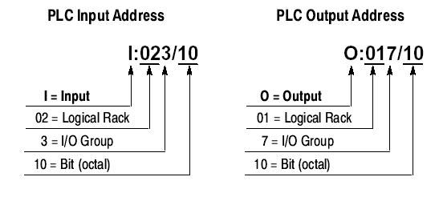
PLC 5 Addressing

Slide 69

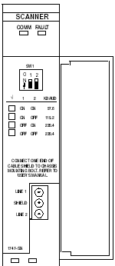
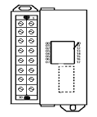
SLC Rack Configuration
SLC Rack Configuration Worksheet
 | Type: |  |  | Type: |  |  | Type:
 | Slot #: |  |  | Slot #: |  |  | Slot #:
 | Baud Rate: |  |  | Word: |  |  | Word:
 |  |  |  | # of bits: |  |  | # of bits:
 |  |  |  | Processor
 |  |  |  | Slot #:
 |  |  |  | Baud Rate:
 |  |  |  | Processor Type:

Slide 70
END OF DAY 3

Slide 71
DAY 4

Slide 72
Review
Review and questions from Day 3
Comments and Symbols – How to Retrieve
Naming structure (Saved from Online Session)
Processor out of box
Micro Logix 1200
SLC Addressing & PLC 5 Addressing

Slide 73
Remote I/O Scanner Configuration
The Remote I/O Scanner enables communication between an SLC-500 processor and remotely located RIO compatible devices.
The remote I/O Scanner can support up to 32 input image and 32 output image words, each being 16 bits long.( The scanner acts like 32 input and 32 output modules in one slot)
A Rack consists of 8 Input and 8 Output words.
This allows a maximum of 4 Logical Racks.
(32 input/output words/8= 4 logical Racks)

Slide 74
RIO Mapping
Using the RIO Configuration Worksheet and the illustration on the board, lets MAP a few RIO signals.
We will use the SLC DEMO and the attached PV550 for this.
Instructor Objective:
Draw the layout of the SLC DEMO in addition to the RIO
Configuration.
Explain what I/O and ladder logic will be used.
Show how PV is configured

Slide 75
RS-Logix 500 Functions
RS-Logix has quite a few things you can do with it.
Lets look at a few and have you perform them.
Searching.
Forcing.
SLC Instruction Help Screens.
Split Screen.
Cross reference Instruction listings.
Multipoint and /Custom Data Monitor.
Histogram.

Slide 76
END OF DAY 4

Slide 77
DAY 5

Slide 78
Review
Review and questions from Day 4
Remote I/O Scanner
RS Logix 500 Functions

Slide 79
Panelview Operator Terminals
PV Operator Terminals are used to take the place of switches, pushbuttons, and gauges.
They communicate to the SLC-500 through RIO across the Blue Hose.
The catalog number IE: PV550, PV600,PV900 designates the size of the display.

Slide 80
PV
Each one has it’s own program loaded into it.
The PV 550, 600, 900, and 1000 require a 9 pin to 9 pin Serial cable.
The PV1400E requires a 9 pin to 25 pin cable, although the newer ones are now 9 pin to 9 pin.
The PV 300, 550, 600, 900, and 1000 require Panelbuilder 32 Software.
The PV1400E requires Panelbuilder 1400E Software.
Typically they either work or they don’t.
Your job will be to replace them when they do not work!
Replacing them is relatively easy.
You will need to Download the program to them after replacing one.

Slide 81
PV
There are several methods to Upload and Download Panelview programs.
The easiest method is the Serial method.
This is the method we will teach you now.
Student Objective:
Upload and Download to a PV Terminal using the Connection Techniques manual as a reference.
Upload and download to a PV E Terminal using the Connection Techniques manual as a reference.

Slide 82
VFD
There are a variety of Rockwell Automation Variable Frequency Drives that you will be responsible to maintain and replace if necessary.
As an Electrician you will be responsible for not only replacing the failed unit, but making sure the parameters were loaded into the replaced unit.
We will now go through the steps required to Save the parameters and be able to download the parameters in the event you must replace the Drive unit.

Slide 83
In Review
Cannot go On-Line.
What Cables do I need?
Which Software do I use?
What is RS-Linx and how do you configure it?
Where are the Comments and Symbols?
How do I Upload and Download?
The Bits and Word Addresses are different than the documentation.

Slide 84
Completion
Questions from the last 5 Days
Fill out the course evaluation sheet.
This completes the Level 1 Course!

