Slide 1

Brunner International SLC500 Level 3 Training Program

Slide 2
DAY 1

Slide 3
Terminology
RIO (Remote Input/Output)
A Rockwell Automation Communication system utilizing High Speed Serial Communication. (57.6 and 230.4 KB) Commonly called “Blue Hose”.
Transfers information to and from remotely mounted devices to the SLC-500.

Slide 4
Terminology
Serial
Or “RS-232” is a 3 conductor point to point connection.

Slide 5
Terminology
DH+
Data Highway + is a Rockwell Automation designed network that allows multiple processors to communicate with each other.
The connection also allows you to communicate to any of the processors connected to the DH+ network.
Also referred to as “ Blue Hose”
Resembles RIO Network.

Slide 6
Typical Network Configuration

Slide 7
RS-Linx
What is RS-Linx?
RS-linx is a Software communication program developed by Rockwell Automation which is required to allow communication with various Rockwell Automation products.
It is used to LINK together Rockwell Automation Software and various RA hardware.
The LINKS or Configured Drivers are set up in RS-Linx.

Slide 8
RS-Linx
The two Basic Configured Drivers that are required for the vast majority of applications at Brunner are DH+ and Serial or RS-232. (others are available)
DH+ is the most common.
Each requires a different communication cable and configuration of the Driver.
Once set, you normally will not need to change anything else with the Driver configuration.

Slide 9
RS-Linx DH+ Configuration Hands on Demonstration
(Optional) Instructor Walkthrough of a typical DH+ Configuration
Student Objectives:
Create a DH+ Driver (Page 1 of Connections manual)
Go On line to a SLC-5/04 processor (Page 12 of Connections manual)

Slide 10
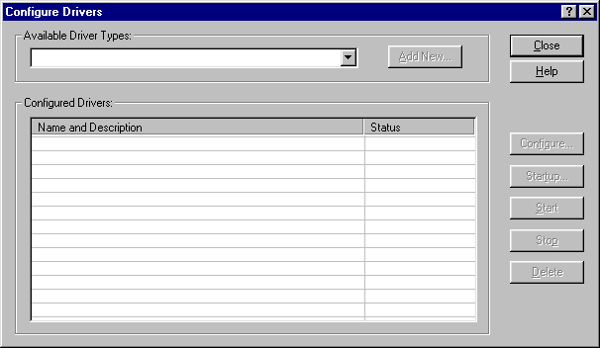
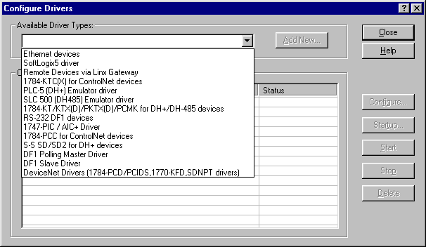
Configuring the DH+ RS-Linx Driver
A
B
Open RS-Linx.
Go to COMMUNICATIONS at the top of the Toolbar.
Click on COMMUNICATIONS, then click on CONFIGURE DRIVERS.
Click on the Pull down arrow labeled A in the diagram above
Click on the selection labeled B in the above diagram.
Click on ADD NEW.

Slide 11
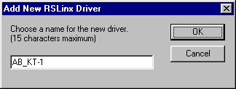
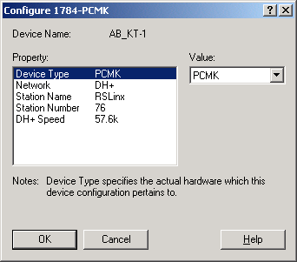
Configuring the DH+ RS-Linx Driver Cont.
D
C
Click on OK in the above diagram.
From the property area click on DEVICE TYPE labeled C.
Go to VALUE and Click on the Pull Down window labeled D.
From the Pull down list, click on PCMK.
Go to the next Property, which is NETWORK and click on it.
Go to VALUE and click on the Pull Down window to select DH+.
Go to the next Property, which is STATION NAME and click on it.
Leave the STATION NAME as RSLinx.
Go to the next Property, which is STATION NUMBER and click on it.
Go to Value and type in a Station Number to use for your computer.
(Recommended values are a number between 70 to 76)

Slide 12

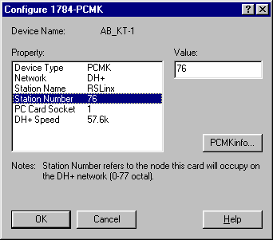
Configuring the DH+ RS-Linx Driver Cont.
The RS-Linx DH+ Driver is now configured!

Slide 13
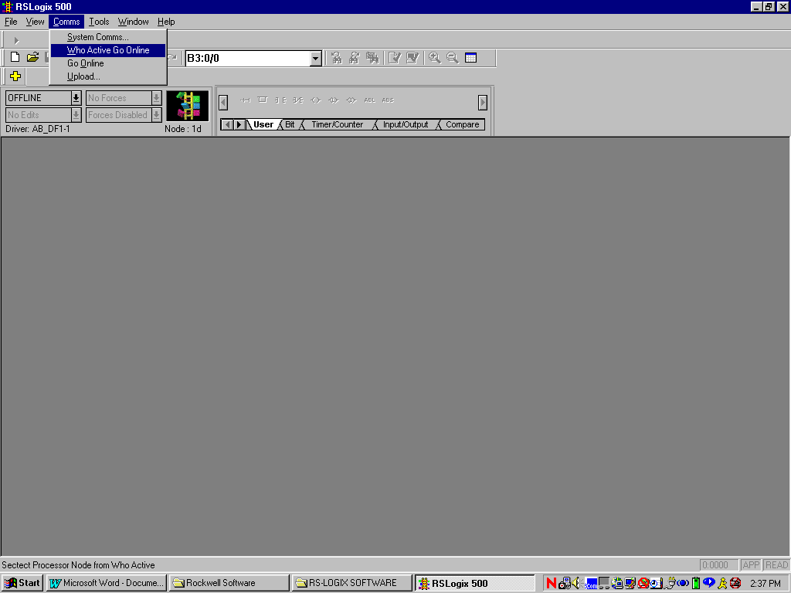
Online Connection to SLC Via DH+
ON LINE CONNECTION TO A SLC PROCESSOR VIA DH+
THIS IS THE MINIMUM REQUIRED TO CONNECT TO A DATA HIGHWAY NETWORK.
THIS WILL NOT GIVE YOU THE COMMENTS AND DESCRIPTORS, JUST THE LADDER LOGIC.
Before starting ensure that this is indeed a Data Highway connection.
This can be determined by looking at the front of the SLC-500.
The DH+ connector is the small 8 pin DIN connector.
The SLC-500 Cable (Cat # 1784-PCM5) will connect from this 8 pin connector to the PCMK card in your computer.
You will also need to have the AB-KT1 DH+ RS-Linx driver configured in RS-Linx.
IF the above steps are not correct, YOU will not be able to communicate to a processor.
Open the RS-Logix 500 software.
Use the mouse to CLICK on Comms then CLICK on Who Active Go Online as per the Illustration below:

Slide 14
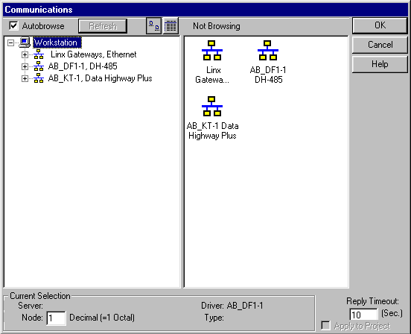
Online Connection to SLC Via DH+ Cont
THE DH+ LIGHT ON THE SLC 500 PROCESSOR SHOULD ALSO BE ON SOLID GREEN.
If the LED is not solid green the DH+ baud rate on the processor is different than the RS-Linx DH+ driver configuration.
The above Illustration is the RS-Linx communication screen.
This is the screen from which you will select one of the RS-Linx drivers.
That RS-Linx driver in turn will show you the processors that are on line.
IF THE AB_KT1 DATA HIGHWAY PLUS Linx driver does not appear you may not have it configured in RS-Linx or you may have Stopped. You would then need to go to RS-Linx and either start it or add it to the list of configured drivers.
Since we are using DH+ you will CLICK on the AB-KT1 Data Highway Plus area as shown below:

Slide 15
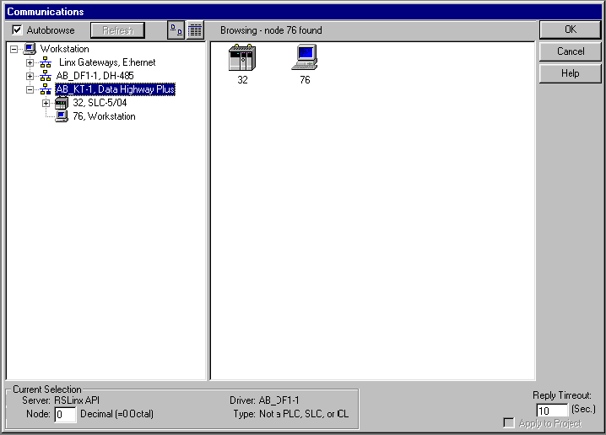
Online Connection to SLC Via DH+ Cont
Upon clicking your mouse on this driver the active processors on the DH+ network will be displayed.
You will also see a computer icon, which is your computer on the DH+ network.
If you see any stations with Red X”S through them, this means those stations are not on the DH+ network you are currently connected to.
You must now determine (if more than one processor is showing) which processor you want to talk to.
You can determine this by looking at the name of the processor on the screen.
The name may contain the Brass Tag or PEE number to identify the processor.
Use your mouse to CLICK on the processor you want to communicate to.Then CLICK your mouse on OK in the upper right hand corner of the window.

Slide 16
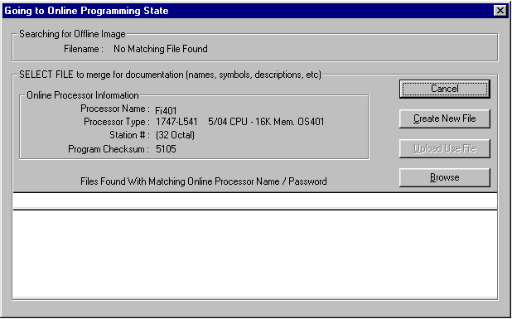
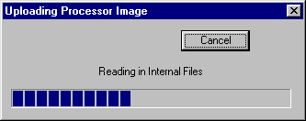
Online Connection to SLC Via DH+ Cont
Use your mouse to Click on Create New File.
The screen below will appear.
Shortly after that another screen will appear briefly saying “Add Default Description Record”
You will now go on-line and the Ladder Logic will appear.
The picture of the ladder will be rotating on the RS-Logix 500 Window indicating to you that you are now on line.
You will not have the comments and descriptors, but you can now use the Ladder Logic manuals provided to find the corresponding descriptions.

Slide 17
RS-Linx Serial Driver Configuration Demonstration
(Optional) Instructor Walk Through a typical RS-232 Configuration
Student Objective:
Create an RS-232 Driver (Page 4 of Connections Manual)
Go On line to a SLC-5/04 processor (Page 8 of Connections Manual)

Slide 18
Configuring the RS-232 RS-Linx Driver
1
2
Open RS-Linx.
Go to COMMUNICATIONS at the top of the Toolbar.
Click on COMMUNICATIONS, then click on CONFIGURE DRIVERS.
Your display may show drivers that have been configured previously.
Click on the Pull Down arrow labeled 1 in the diagram above.
Click on the selection labeled 2 in the figure above.
Click on ADD NEW.

Slide 19
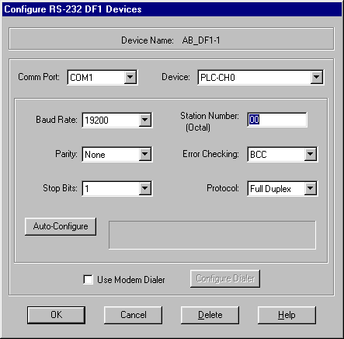

Configuring the RS-232 RS-Linx Driver Cont.
3
AT THIS POINT YOU HAVE 2 OPTIONS
YOU MAY PERFORM AN AUTOCONFIGURE ONLINE, IF YOU HAVE THE RS-232 CABLE CONNECTED TO THE PROCESSOR.
YOU MAY CONFIGURE THE DRIVER OFFLINE
TO AUTOCONFIGURE ON LINE, PERFORM THE FOLLOWING:
Click on the AUTO-CONFIGURE window labeled 3 in the above figure.
RS-Linx will go out on line and configure the driver automatically for you.
If the autoconfigure worked properly the message AUTO CONFIGURATION SUCCESSFUL will appear.
You are now ready to use the RS-232 Driver in RS-Logix.
You may now exit out of RS-Linx and begin using the RS-Logix software.

Slide 20
Online Connection to SLC (RS-232)
ON LINE CONNECTION TO A SLC PROCESSOR VIA THE RS-232 PORT
THIS WILL NOT GIVE YOU THE COMMENTS AND DESCRIPTORS, JUST THE LADDER LOGIC.
When you connect via RS-232 you are connecting directly to one processor only.
Before starting ensure that this is indeed an RS-232 connection.
This can be determined by looking at the front of the SLC-500.
The RS-232 connection is the 9 pin connector on the SLC-500 processor module.
The SLC-500 Cable (Cat # 1747-CP3) will connect from this 9 pin connector to the 9 pin Com port on your computer.
You will also need to have the AB-DF1 DH-485 RS-Linx driver configured in RS-Linx.
IF the above steps are not correct, YOU will not be able to communicate to a processor.
Open the RS-Logix 500 software.
Use the mouse to CLICK on Comms then CLICK on Who Active Go Online

Slide 21
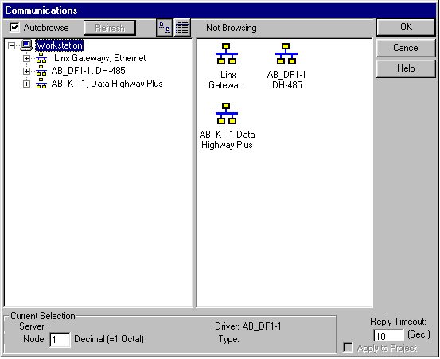
Online Connection to SLC (RS-232) Cont.
Illustration is the RS-Linx communication screen.
This is the screen from which you will select one of the RS-Linx drivers.
That RS-Linx driver in turn will show you the on line processor.
IF THE AB-DF1 DH-485 Linx driver does not appear you may not have it configured in RS-Linx or you may have it Stopped. You will then need to go to RS-Linx and either start it or add it to the list of configured drivers.
Since we are using RS-232 communication use your mouse to CLICK on the AB-DF1 DH-485 area as shown:

Slide 22
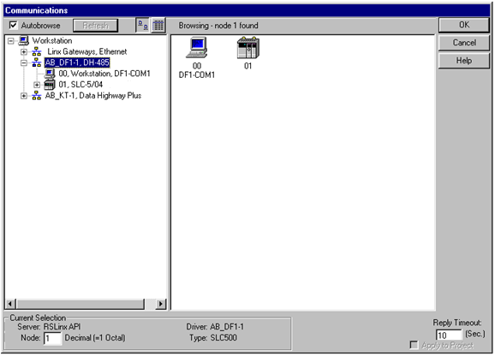
Online Connection to SLC (RS-232) Cont.
Upon clicking your mouse on this driver the active processor on the AB-DF1 DH-485 network will be displayed.
You will also see a computer icon, which is your computer on the AB-DF1 DH-485 network.
If you see any stations with Red X”S through them, this means that those stations are not on the network you are currently connected to.
Use your mouse to CLICK on the processor you want to communicate to. Then CLICK your mouse on OK in the upper right hand corner of the window.
The next screen to come up will be as follows:

Slide 23
Online Connection to SLC (RS-232) Cont.
You will now go on-line and the Ladder Logic will appear.
The picture of the ladder will be rotating on the RS-Logix 500 Window, indicating that you are now on-line.
You will not have the comments and descriptors, but you can now use the Ladder Logic manuals provided to find the corresponding descriptions.
Use your mouse to Click on Create New File

Slide 24
RS-Linx Drivers
There are several RS-Linx Driver configurations that are available.
The Han Tek Main Control has the option to use the Ethernet Driver.
A copy of the procedure to configure this Driver (RS Linx DH+, RS-232) will be given to you by your instructor.

Slide 25
Comments and Symbols
What are Comments and Symbols?
Comments and Symbols or Descriptors are text that is used to describe various rungs of ladder logic or individual inputs and outputs.
They are created by the programmer who developed the ladder logic.
They do not reside in the SLC-500 processor, but on your computer in a project file with an extension of .RSS.
If the .RSS file you have does not contain them, you will only display the ladder logic.
To display Comments and Symbols you must either have them on a floppy disk, or on your computer.

Slide 26
Project file Extension
All ladder logic project files are stored with the following extensions:
SLC-500 example Project file: BT123.RSS.
BT123 is the Project file name.
.RSS is the extension and stands for Rockwell Software SLC.

Slide 27
SLC-500 Back up File
SLC-500 example Back up File: BT123_Bak01.RSS.
BT123 is the project file name.
_Bak01 designates a backed up file.
A back up version of a project file is created anytime a project is saved or closed.
The HIGHER the number, the more recent the backup.

Slide 28
Comments and Symbols
The preferred method to retrieve or merge the Comments and Symbols to your program is to:
Copy or Drag and Drop the .RSS file with the comments and symbols from a floppy to your computer.
Run the file directly from your computer as the file now resides on your computer.

Slide 29
Comments and Symbols
2 other methods can be used but they can create additional problems:
Perform an Ascii or Native Import.
This method can be used but this method does not import the ladder program file names.
Run the program directly from the floppy disk.
This can cause A: drive read errors if you remove the floppy before completely shutting down RS-Logix 500.

Slide 30
Comments and Symbols
We will concentrate our efforts to the first method.
Student Objective:
Copy the program “CNCTS” given to you by your instructor unto your hard drive.
Open the program to verify Comments and Symbols are available.
Download the program to the Trainer.
When you go on line you will now have the Comments and Symbols.

Slide 31
Comments and Symbols
You may experience an instance when you go online to a processor and the Comments and Symbols come up automatically without you having to copy the program to your hard drive.
The reason for this is in the way RS-logix searches for programs on your hard drive.

Slide 32
Comments and Symbols
RS-Logix Does not search using the (Proc Name) .RSS nomenclature.
RS-Logix searches into the .RSS file for the Controller Properties, Processor name and Checksum number.
A typical example of this follows:

Slide 33
Comments and Symbols
Scenario:
You have saved the same program 5 times but with a different name each time.
The program was not modified during any of those 5 saves.
In this case they were saved as follows:
test1.rss, test2.rss, test3.rss, test4.rss, and test5.rss.
Each has a controller properties name within the .RSS file as “DEMO”.
When you perform a Who Active Go on line , RS-Logix first searches for all the .rss files with an internal Controller Properties name of “DEMO”.

Slide 34
Comments and Symbols
In this case it will find 5 of them.
RS-Logix will now examine the internal Checksum value on the Controller Properties screen of each program and compare it to the checksum value currently in the SLC-5/04 you are connected to.
If there is a match, that is the program that is opened.
If more than 1 program has the same Checksum value, RS-Logix determines which one it will open.
RS-Logix will only open the file if the Controller Properties and Checksum value are the same.

Slide 35
Comments and Symbols
If there is no match to any of them, the Create New File/Browse Screen will appear.
You now become responsible for picking which of the 5 programs you want to download.
Note: The program you pick may not necessarily be the most current version.
The only time the Checksum number will change is when you modify and save the program.

Slide 36
SLC Out of the Box
What is SLC Out of the Box?
SLC Out of the Box is a SLC 500 processor that is being used for the very first time.
It is not a processor that has been used at one time and then put on the shelf.
It is a Processor from the factory still in the Anti Static Bag.
The processor is factory defaulted to Node address 1.
In a single stand alone application this does not pose a major problem, but machine with multiple stations with processors, this Node address may cause a conflict.
Notes:
Draw on the board there computer with node address 76 and connected to 5 processors with node addresses 1 thru 5.
Replace node 3 with the OUT OF THE BOX processor, noting that this processor will now become node address 1 as well, causing a conflict with the other node address 1 processor.
A couple of ways around this would be to disconnect the Blue hose so there is no conflict and also you could load in the program using RS-232 communications.

Slide 37
Micrologix 1200
A Micro SLC processor.
Requires a 1761-CBL-PM02/C cable to communicate to it.
RS-Linx Driver is configured for RS-232 Serial communications.
RS-Logix 500 Software is used to view the ladder logic.

Slide 38
Micrologix 1200 Online Lab
Student Objective:
Go on line to the Micrologix 1200.

Slide 39
SLC and PLC Addressing
SLC/PLC Scanner and Address handouts.

Slide 40
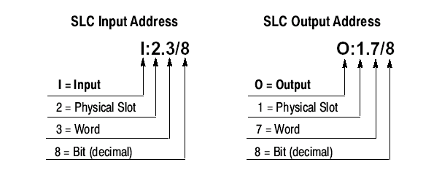
SLC 5/04 Addressing
Word is used when you have remote I/O racks or communication through a specialty module like a Scanner

Slide 41
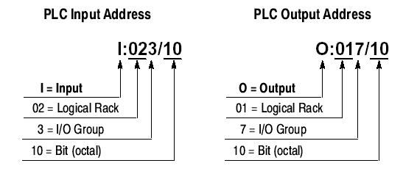
PLC 5 Addressing

Slide 42

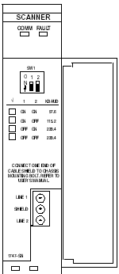
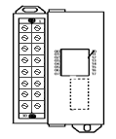
SLC Rack Configuration
SLC Rack Configuration Worksheet
 | Type: |  |  | Type: |  |  | Type:
 | Slot #: |  |  | Slot #: |  |  | Slot #:
 | Baud Rate: |  |  | Word: |  |  | Word:
 |  |  |  | # of bits: |  |  | # of bits:
 |  |  |  | Processor
 |  |  |  | Slot #:
 |  |  |  | Baud Rate:
 |  |  |  | Processor Type:

Slide 43
Remote I/O Scanner Configuration
The Remote I/O Scanner enables communication between an SLC-500 processor and remotely located RIO compatible devices.
The remote I/O Scanner can support up to 32 input image and 32 output image words, each being 16 bits long.( The scanner acts like 32 input and 32 output modules in one slot)
A Rack consists of 8 Input and 8 Output words.
  This allows a maximum of 4 Logical Racks.
  (32 input/output words/8= 4 logical Racks)

Slide 44
RIO Mapping
Using the RIO Configuration Worksheet and the illustration on the board, lets MAP a few RIO signals.
We will use the SLC DEMO and the attached PV550 for this.
Instructor Objective:
Draw the layout of the SLC DEMO in addition to the RIO
Configuration.
Explain what I/O and ladder logic will be used.
Show how PV is configured

Slide 45
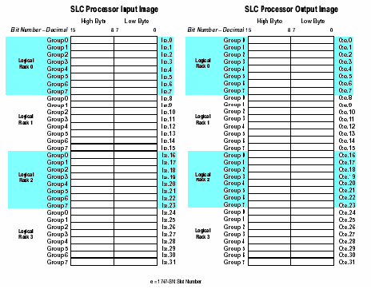
Rio Configuration Worksheet
I | : |  | . |  | /
O | : |  | . |  | /

Slide 46
RS-Logix 500 Functions
RS-Logix has quite a few things you can do with it.
Lets look at a few and have you perform them.
Searching.
Forcing.
SLC Instruction Help Screens.
Split Screen.
Cross reference Instruction listings.
Multipoint and /Custom Data Monitor.
Histogram.

Slide 47
Panelview Operator Terminals
PV Operator Terminals are used to take the place of switches, pushbuttons, and gauges.
They communicate to the SLC-500 through RIO across the Blue Hose.
The catalog number IE: PV550, PV600,PV900 designates the size of the display.

Slide 48
PV
Each one has it’s own program loaded into it.
The PV 550, 600, 900, and 1000 require a 9 pin to 9 pin Serial cable.
The PV1400E requires a 9 pin to 25 pin cable, although the newer ones are now 9 pin to 9 pin.
The PV 300, 550, 600, 900, and 1000 require Panelbuilder 32 Software.
The PV1400E requires Panelbuilder 1400E Software.
Typically they either work or they don’t.
Your job will be to replace them when they do not work!
Replacing them is relatively easy.
You will need to Download the program to them after replacing one.

Slide 49
PV
There are several methods to Upload and Download Panelview programs.
The easiest method is the Serial method.
This is the method we will teach you now.
Student Objective:
Upload and Download to a PV Terminal using the Connection Techniques manual as a reference.
Upload and download to a PV E Terminal using the Connection Techniques manual as a reference.

Slide 50
END OF DAY 1

Slide 51
DAY 2

Slide 52
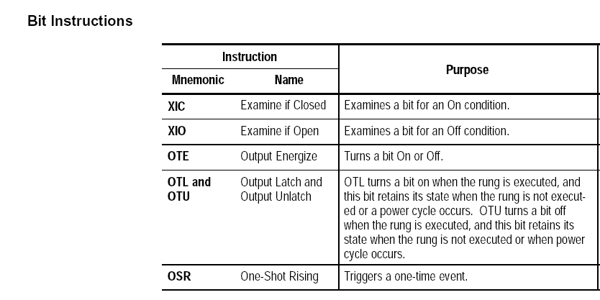
SLC 5/04 Bit Instructions
Notes:
Go through and explain what the XIC, XIO and OTE instructions are.

Slide 53
Examine If Closed (XIC) Also called
Normally Open or Examine On
Use the XIC instruction in your ladder program to determine if a bit is on.

Slide 54
Examine if Open (XIO) Also called
Normally Closed or Examine Off
Use the XIO instruction in your ladder program to determine if a bit is off.

Slide 55
Output Energize (OTE)
Use the OTE instruction in your ladder program to turn on a bit when rung conditions are evaluated as true.

Slide 56
XIC, XIO, OTE EXAMPLE
What you will see is a typical ladder logic diagram with the XIC, XIO, and OTE instructions.

Slide 57
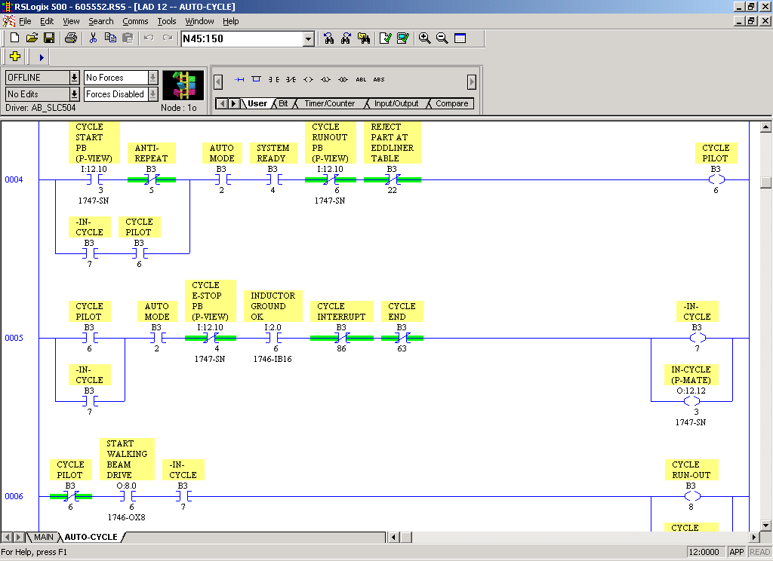
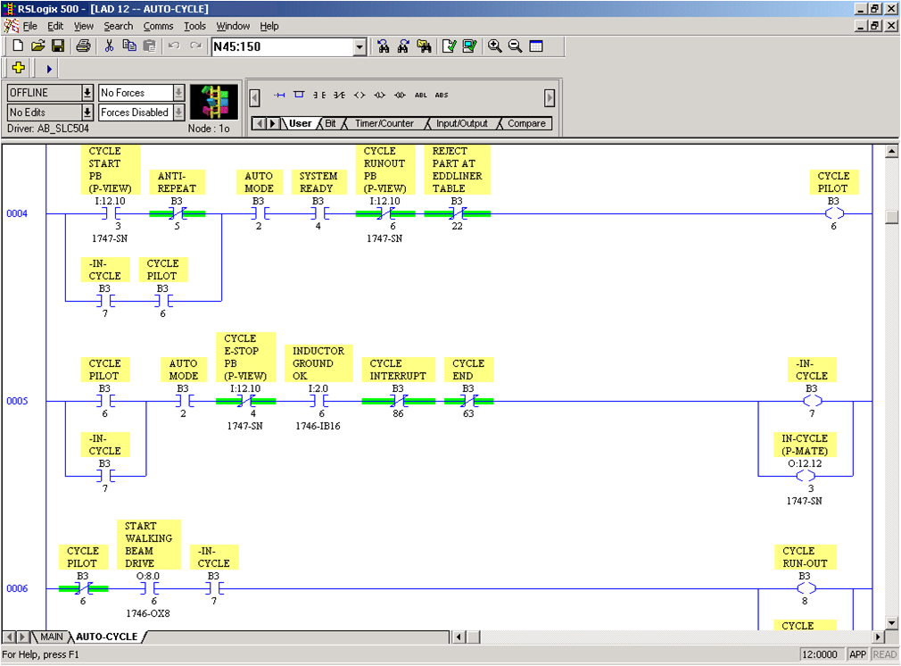

Slide 58
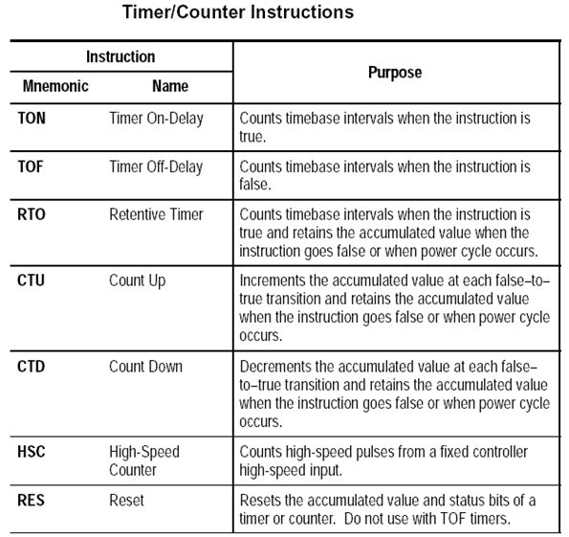
TIMERS AND COUNTERS

Slide 59
Timers and Counters
Timer Instructions Overview
Each Timer consists of 3 words.
Word 0 is the Control word. It consists of 3 addressable bits:
Bit 13 is the Done (DN) bit.
Bit 14 is the Timer Timing (TT) bit.
Bit 15 is the Timer Enable (EN) bit.
Word 1 stores the Preset value.
Word 2 stores the Accumulated value.

Slide 60
TIMER ON DELAY
Use the TON instruction to turn an output on or off after the timer has been on for a preset time interval
This is the Timers address in the database
Determines the duration of each time interval
The value the timer must reach before the done bit will come on
The elapsed time since the timer was reset
Notes:
This is a typical example of a timer with a 1 second time base and a 30 second preset

Slide 61
Timer Off Delay
Use the TOF instruction to turn an output on or off after its rung has been off for a preset time interval.
The TOF instruction begins to count timebase intervals when the rung makes a true-to-false transition.
When the input condition is true, the EN and DN bits will be on, until the input condition goes false, and the ACCUM value is equal to or greater than the PRESET value
This is the Timers address in the database
Determines the duration of each time interval
The value the timer must reach before the done bit will come on
The elapsed time since the timer was reset

Slide 62
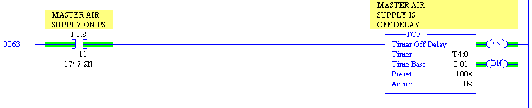
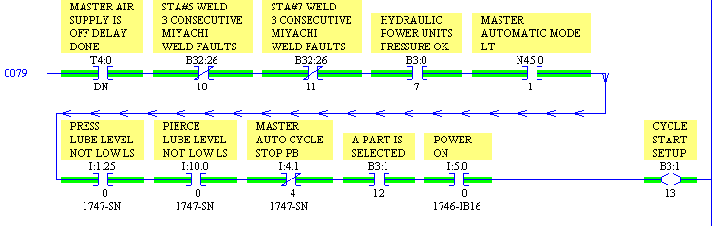
TOF Timer Example
If the Master Air supply switch I:1.8/11 drops out for less than 1 second (.01x100), the Done bit will remain on.
This helps to get rid of any minor air pressure fluctuations that could shut the machine down
This also is used for switch debounce

Slide 63
Retentive Timer On Delay (RTO)
The RTO instruction works the same way as a TON instruction, with the exception that once it has begun timing, it will hold the count even if the rung goes false, a fault occurs, the keyswitch position changes or power is lost.
This is the Timers address in the database
Determines the duration of each time interval
The value the timer must reach before the done bit will come on
The elapsed time since the timer was reset

Slide 64
RESET (RES)
The RES instruction is used to reset timers and counters. When conditions preceding it in the rung are true, the RES resets the accumulated value and control bits of the timer or counter.

Slide 65
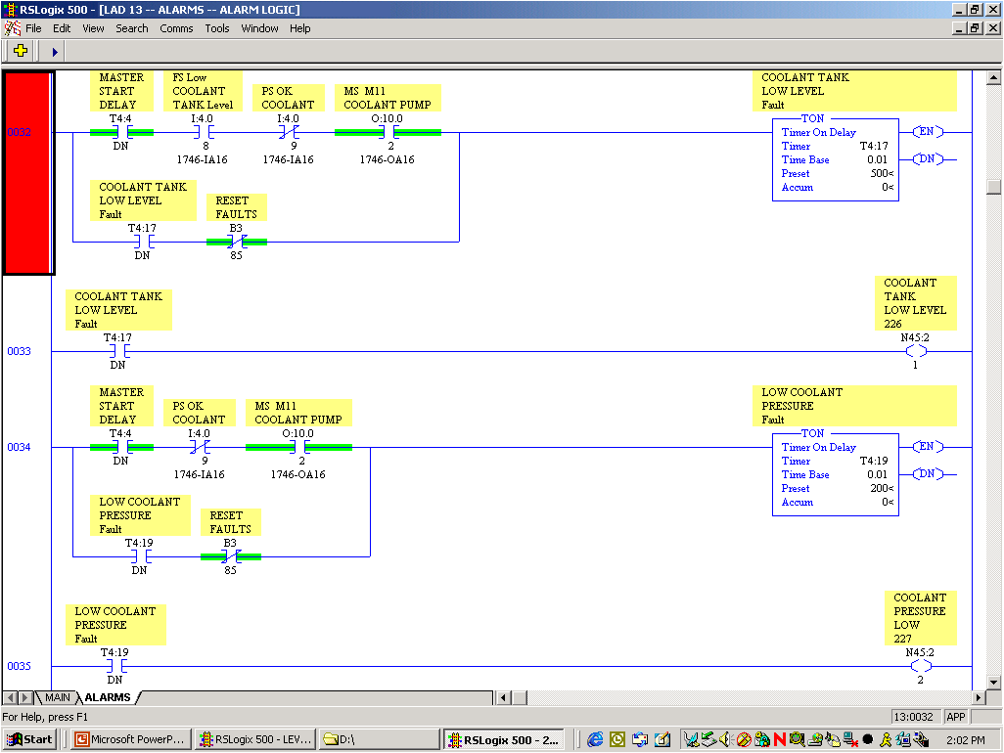

Slide 66
Counters
Counter Instructions Overview
Each Counter consists of 3 words.
Word 0 is the Control word. It consists of 6 addressable bits that contain the status of the instruction:
Bit 10 is the Update Accum Value (UA) Used only in the fixed controller
Bit 11 is the Underflow (UN) bit.
Bit 12 is the Overflow (OV) bit.
Bit 13 is the Done (DN) bit.
Bit 14 is the Count Down (CD) enable bit.
Bit 15 is the Count Up (CU) enable bit.
Word 1 stores the Preset value.
Word 2 stores the Accumulated value.

Slide 67
Cont Up (CTU)
This output instruction counts up for each false-to-true transition of conditions preceding it.
The CTU produces an output when the accumulated value reaches the preset value.
Rung transitions might be triggered by a limit switch or by parts traveling past a detector.

Slide 68
Count Down (CTD)
This output instruction counts down for each false-to-true transition of conditions preceding it.
The CTD produces an output when the accumulated value reaches the preset value.
Rung transitions might be triggered by a limit switch or by parts traveling past a detector.
Notes:
At the end of this have a lab or labs tthat demonstrated timers and counters and resets

Slide 69
RESET INSTRUCTION (RES)
The RES instruction is used to reset timers and counters.

Slide 70
LAB 1
Timers and Counters

Slide 71
OUTPUT LATCH AND UNLATCH
This instruction functions much the same as the OTE with the exception that once a bit is set with an OTL, it is "latched" on.
Once an OTL bit has been set "on" (1 in the memory) it will remain "on" even if the rung condition goes false.
The bit must be reset with an OTU instruction.
Latch and unlatch instructions must be assigned the same address in your logic program.

Slide 72
Fill (FLL) Instruction
The Fill instruction loads a source value into each position of the destination file.

Slide 73
Clear (CLR) Instruction
Use the CLR instruction to set the destination value of a word to 0 (zero)
Typically the CLR instruction is used in the beginning of a program to clear all the Latches when the program starts.

Slide 74
LAB 2
Latch/Unlatch/FLL/CLR Instructions

Slide 75
JSR JMP LBL INSTRUCTIONS
JSR Jump To Subroutine
JMP Jump
LBL Label

Slide 76
JSR Instruction
JUMP TO SUBROUTINE
The JSR instruction is used to direct the controller to execute a separate subroutine file within the ladder program and return to the instruction following the JSR instruction.
All RS-Logix programs must have these subroutines in them in order to execute the various Program ladder files.
If they are not in the Logic the entire Ladder program file referenced by that subroutine is ignored.
They are typically located at the end of the LAD 2 Program file
This is why in Lab 2 you entered a JSR at the end of the file.
Notes:
Show real life program and also demonstrate or have a lab set up to do he jsr and jmp and lbl instruction

Slide 77
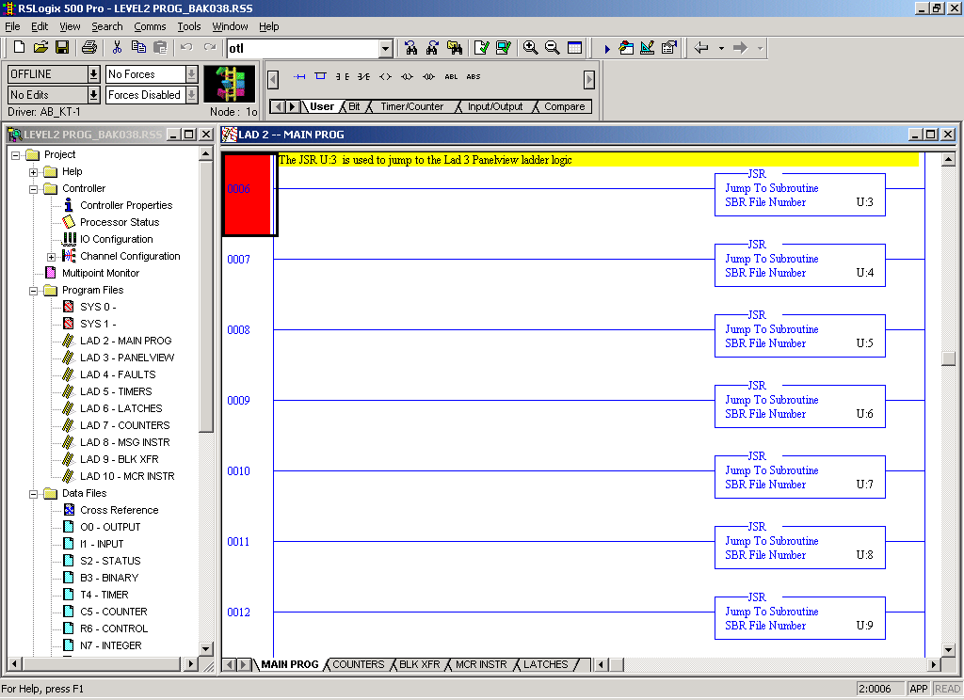

Slide 78
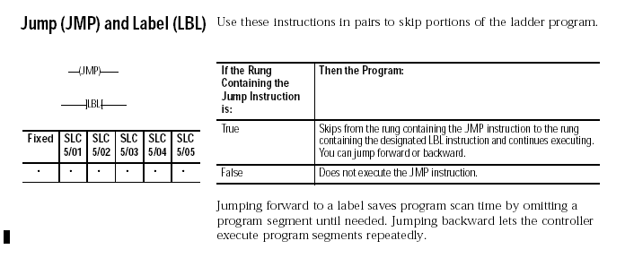
Jump (JMP) and Label (LBL)

Slide 79
Jump (JMP) and Label (LBL)
The Jump (JMP) and Label (LBL) instructions are used to SKIP over portions of the ladder logic.

Slide 80
LAB 3
JMP and LBL Instructions

Slide 81
MATH INSTRUCTIONS
ADD
SUBTRACT
MULT
DIV
CPT (Compute)

Slide 82
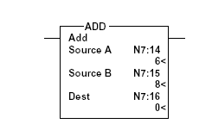
ADD (Add)

Slide 83
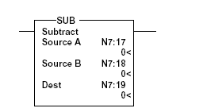

SUB (Subtract)

Slide 84
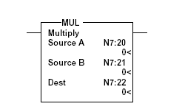

MUL (Multiply)

Slide 85
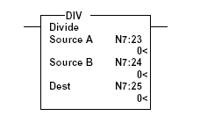
DIV (Divide)

Slide 86

CPT (Compute) Instruction
Use the CPT (Compute ) instruction to Compute a mathematical expression and store the result in a Destination

Slide 87
Lab 4
Math Instructions

Slide 88
Move (MOV) Instruction
The Move (MOV) Instruction MOVES the Source value to a Destination location, as long as the rung remains true.
The instruction moves the data each scan
When the rung is true, the T4:3 accumulated value is MOVED to destination N45:155.

Slide 89
Copy (COP) Instruction
This instruction copies blocks of data from 1 location to another

Slide 90
Lab 5
MOV/COP Instruction

Slide 91
One Shot Rising (OSR) Instruction
The OSR is a retentive input instruction that triggers an event to occur one time.
Use the OSR instruction when an event must start based on the change of state of the rung from false to true.

Slide 92
Lab 7
OSR (One Shot Rising)

Slide 93
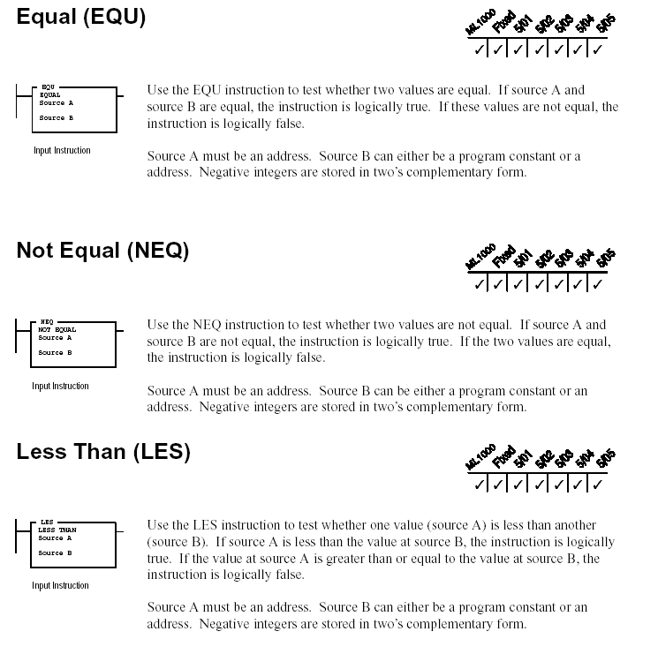
EQU NEQ LES INSTRUCTIONS

Slide 94
Equal (EQU) Instruction
Use this instruction to test to see if 2 values are Equal.
If they are equal the Instruction is True
If they are not Equal the Instruction is False

Slide 95
Not Equal (NEQ)
Use the NEQ instruction to test if 2 values are not Equal.

Slide 96
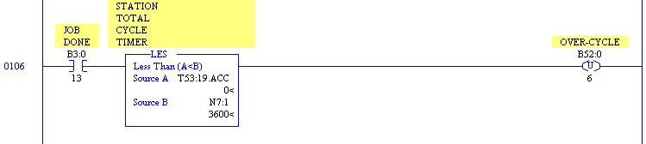
Less Than (LES) Instruction
This instruction tests whether the value in Source A is Less Than the value in Source B.
If Source A is Less Than Source B, the Instruction is True.
If Source A is Greater than Source B, the Instruction is False.

Slide 97
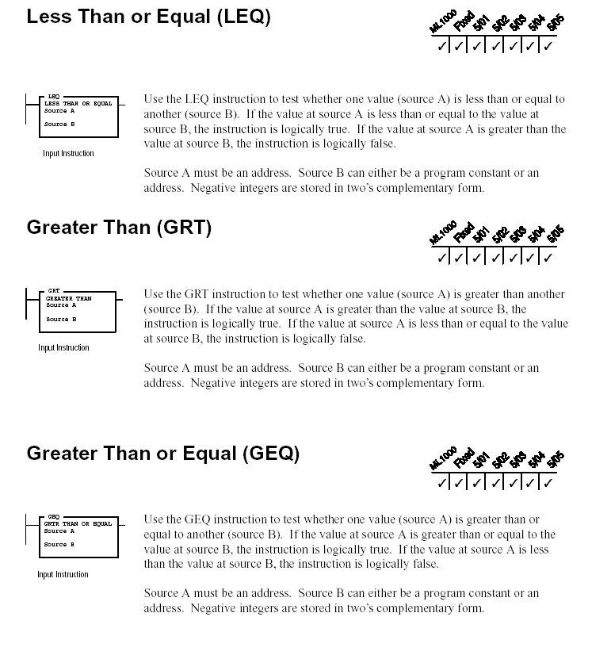
LEQ GRT GEQ INSTRUCTIONS

Slide 98
Less Than or Equal (LEQ) Instruction
This instruction tests whether Source A is Less Than or Equal to Source B.
If the value of source A is Less Than or Equal to Source B, the Instruction is True.
If the value of Source A is Greater Than Source B, The instruction is False.

Slide 99
Greater Than (GRT) Instruction
This instruction tests whether Source A is Greater than Source B.

Slide 100
Greater Than or Equal (GEQ) Instruction
This instruction tests whether source A is Greater Than or Equal to Source B.

Slide 101
Limit (LIM) Instruction
Use the Limit instruction to test for values within or outside a specified range, depending on how you set the limits.

Slide 102
Lab 6
EQU, NEQ, LES, LEQ, GRT, GEQ, LIM Instructions

Slide 103
What is Remote I/O ?
Remote I/O are devices that are remotely located ( up to 10,000 feet) from the SLC-500 processor rack.
Communication between the devices occurs over twisted pair cable commonly called Blue Hose, connected in a daisy chain fashion.
The 1747-SN Remote I/O Scanner enables communication between the SLC-500 rack and the remotely located devices.

Slide 104
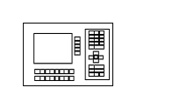

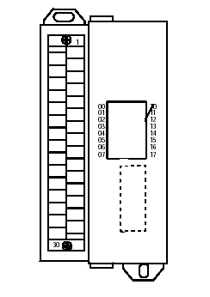
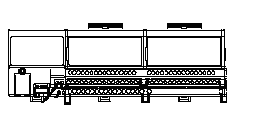
TYPICAL RIO NETWORK LAYOUT
 | SLC-500 |  |  | PV 1000 |  | 1791 Block I/O | 1791 Block I/O |  | 1791 Block I/O |  | 1794 Flex I/O

Slide 105
RIO DIP Switch and Addressing
The most difficult process of RIO is in determining the DIP Switch Settings and Addressing of the Devices on the Network

Slide 106
1747-SN Scanner
The most common item connected to the RIO is the 1747-SN Scanner module.
The 1st part of the Remote I/O starts at the 1747-SN Scanner module.
The module resides in the SLC-500 rack and is responsible for the communication to and from other Remote I/O devices connected to it.

Slide 107
Remote I/O Scanner Configuration
The Remote I/O Scanner enables communication between an SLC-500 processor and remotely located RIO compatible devices.
The remote I/O Scanner module can support up to 32 input image and 32 output image words, each being 16 bits long.
A Rack consists of 8 Input and 8 Output words.
This allows a maximum of 4 Logical Racks.
(32 input/output words/8= 4 logical Racks)

Slide 108
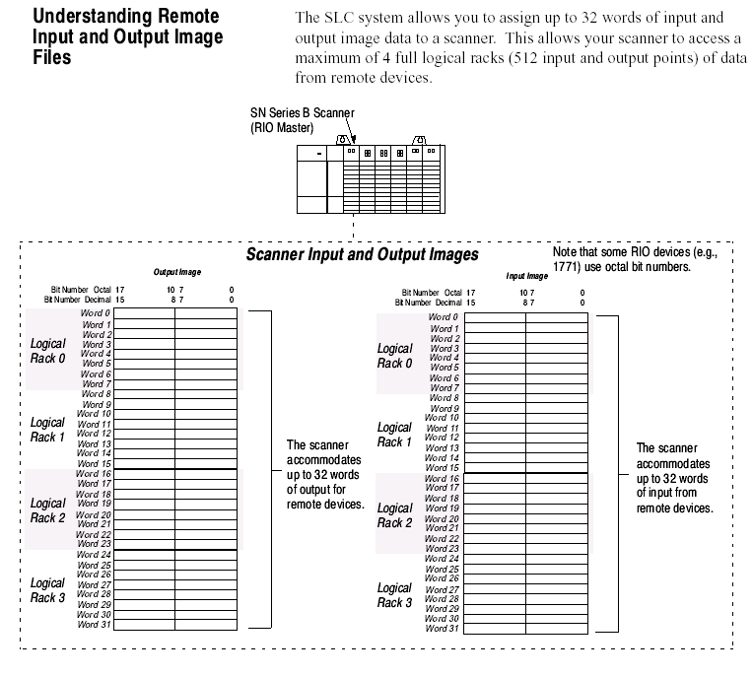
Scanner I/O Image Table

Slide 109
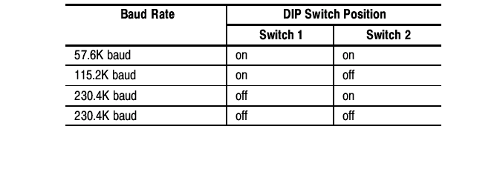
Scanner Hardware Features

Slide 110
1747-SN Troubleshooting

Slide 111
Additional Items that may be Connected to Remote I/O
1746-Direct Communication Module
Panelview Terminals
1794 Flex I/O
1791 Block I/O
1305/ 1336 Plus VFD Drives

Slide 112
1746 DCM Direct Communication Module
The Direct Communication Module Catalog Number 1746-DCM is used to connect a SLC-500 to a supervisory Allen Bradley Programmable Controller via the RIO link, thereby providing a distributed processing system.
What this means is that it allows the SLC-500 to connect to the PLC 5 Processor
The DCM module has Dip Switches that need to be set up when you replace the module.

Slide 113
Panelview Terminals
Panelview RIO configuration is performed in the Panelbuilder32 Software.
The OEM or Engineer will typically configure the information so it may talk to the 1747-SN Scanner module.
The configuration data that is downloaded to the Panelview can be observed on the Terminal by accessing the Configuration Set up Screen.
On the PV550, 600, 900 and 1000 this is accomplished by depressing the right and left arrow keys at the same time.
Notes:
Show this screen, then demonstrate on the PV terminals how to get to them.

Slide 114
1794-Flex I/O

Slide 115
Flex I/O
Flex I/O consists of 3 Components:
Adapters Terminal BaseUnit I/O Modules

Slide 116
Diagnostic Indicators
Adapter Active (Green)
Adapter Fault (Red)
Local Fault (Red)
I/O Module
Flex Bus Connector
Keyswitch
Flex Bus Connector
Terminal Base
24 VDC Power Connection
Address/Group Switches
Terminal Strips
Reset PB.
Used to reset the adapter and resume communication when a Comm error occurs
Remote I/O Wiring connections
BLUE HOSE

Slide 117
Flex I/O
An I/O Rack can consist of up to 8 Modules
Flex I/O is very common and seen on many applications throughout Industry.

Slide 118
G Files
G Files-What are they?
G files are used by Specialty Modules
What are Specialty Modules?
A specialty module is any module other than a discrete I/O module.
Think of G Files as Software Dip Switches in the SLC-5/04
G Files can only be configured off-line
G Files let the SLC-5/04 processor know how the devices on the RIO network are configured.
The G File data is passed to the specialty module when you go to the Run mode on the processor.
If the G Files are not configured properly, the 1747-SN Scanner module Green Comm LED WILL NOT be solid Green but will be Flashing Green.

Slide 119
LAB 8
The best approach to learning how to configure and set up the RIO is best done via hands on.
We will do this with Lab 8.

Slide 120
Lab 8
RIO Configuration

Slide 121
DEMO RIO NETWORK LAYOUT
 | SLC-500 |  |  | PV 1000 |  | 1791 Block I/O | 1791 Block I/O |  | 1791 Block I/O |  | 1794 Flex I/O

Slide 122
RIO Addressing

Slide 123
RIO Addressing
RIO addressing is the method used to address devices on the RIO network.
The devices use the same type of addressing scheme as normal I/O.
You must take into consideration the Logical Rack Address of the device as this determines the WORD number you will use .
Notes:
Using the remote scanner I/O map explain the remote I/o data table and addressing.

Slide 124
Remote I/O Scanner Configuration
The Remote I/O Scanner enables communication between an SLC-500 processor and remotely located RIO compatible devices.
The remote I/O Scanner can support up to 32 input image and 32 output image words, each being 16 bits long.
A Rack consists of 8 Input and 8 Output words.
This allows a maximum of 4 Logical Racks.
(32 input/output words/8= 4 logical Racks)

Slide 125
RIO Mapping
Using the Remote Scanner I/O Map Handout supplied along with your Demo RIO layout and the RIO Configuration worksheet from Lab 8, lets MAP a few RIO signals.
(This was covered briefly in Level 1)

Slide 126
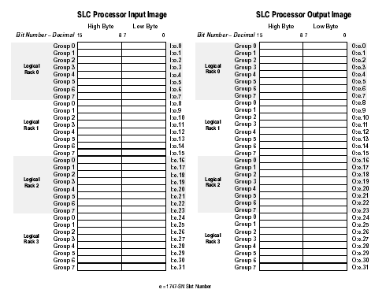
Remote Scanner I/O Map
Input or Output |  | Scanner Slot Location |  | Word Within the Logical Rack |  | Bit Number
I | : |  | . |  | /
O | : |  | . |  | /

Slide 127
Lab 9
RIO Addressing

Slide 128
END OF DAY 2

Slide 129
DAY 3

Slide 130
Indirect Addressing
Indirect Addressing:
Indirect addressing is valid with SLC 5/03 OS302, SLC 5/04 OS401, or SLC 5/05 and MicroLogix 1500 processors only.
An indirect address is one that lets you substitute a word or bit number in a logical address with the value in another address. The processor uses the value from the substitute address to form the indirect address. You can use ladder logic to change the value stored at the substitute address.
Enter the substitute address in brackets [ ].
You can use M files to contain values used to calculate indirect address locations.
Example:
B3:[N7:1]/[N7:12] - In this example the word number is stored in integer address N7:1, and the bit number is stored in integer address N7:12.
If the referenced indirect address element is outside the data file limit an error occurs.
In the example provided taken from Scanner 3 the programmer is using Indirect Addressing to move data from #N11:0 to indirect address #N[N7:120]:0 with a length of 128 words. The Indirect Address is assigned by reviewing the value in N7:120, which = 52. This means that the value from N11:0 is copied into N52:0 with a length of 128 words.
On the next branch the programmer is copying data from N11:128 to N52:128 using the Indirect Addressing statement #N[ 7:120]:128.

Slide 131
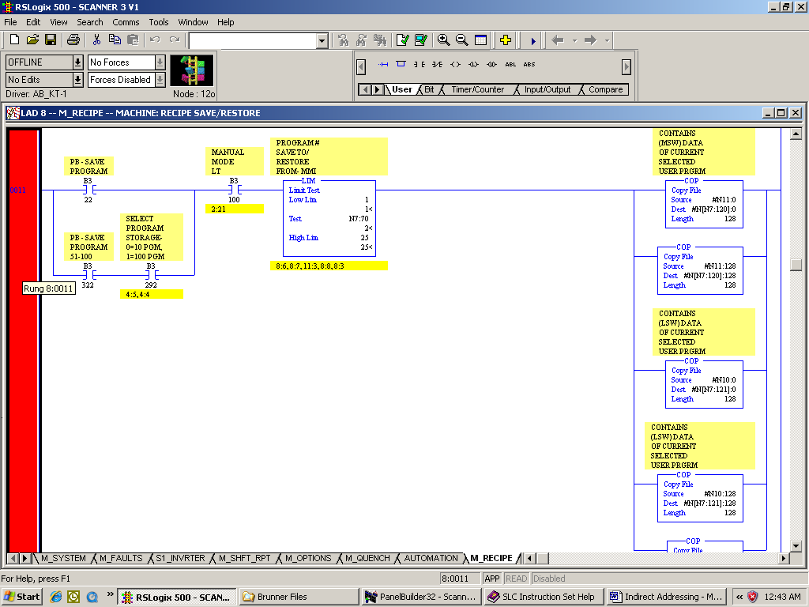

Slide 132
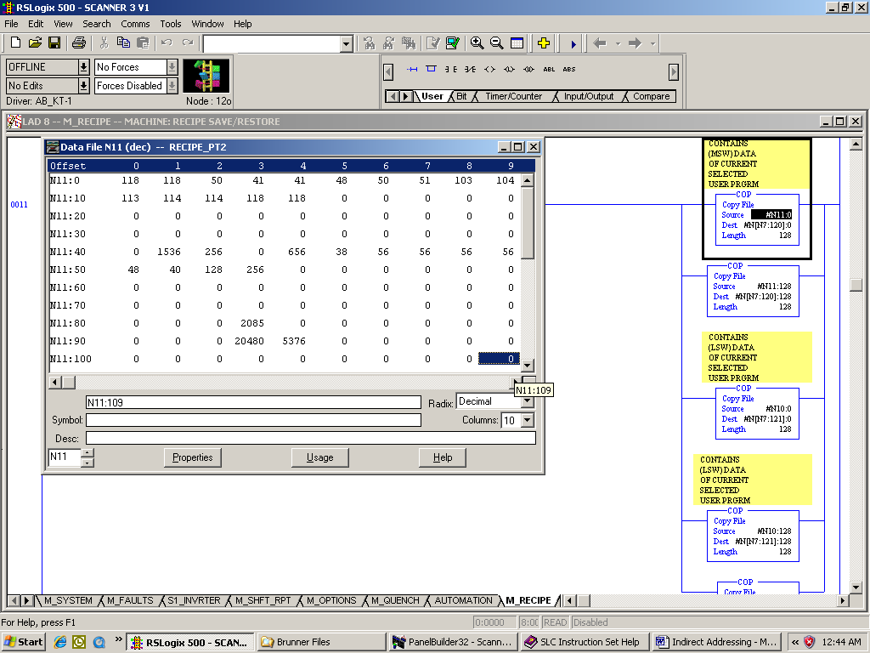

Slide 133
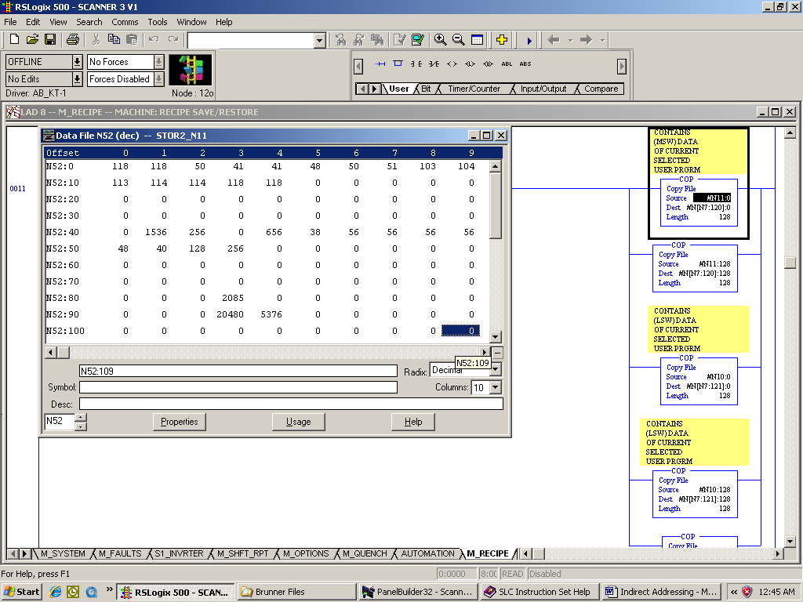

Slide 134
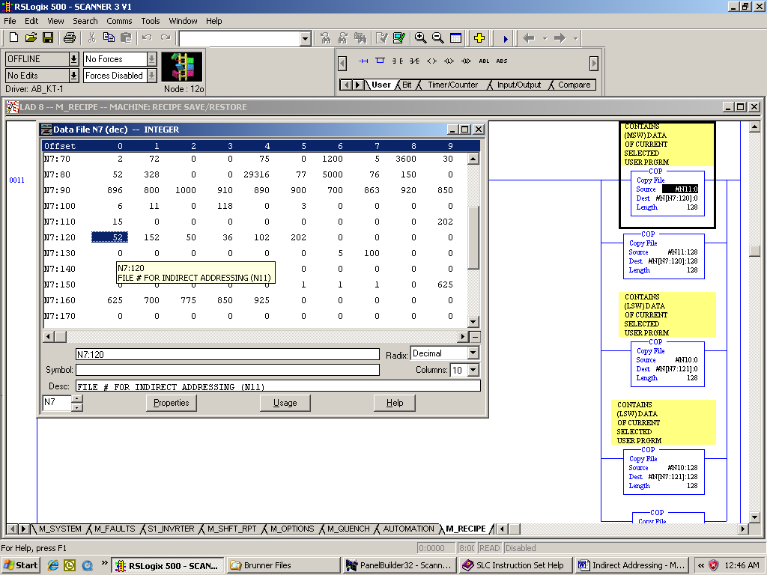

Slide 135
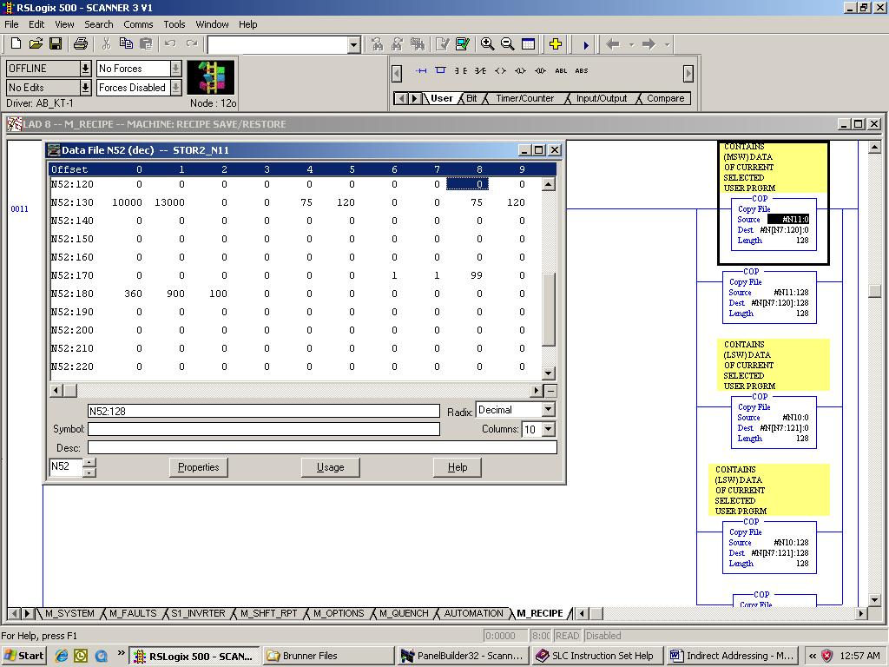

Slide 136
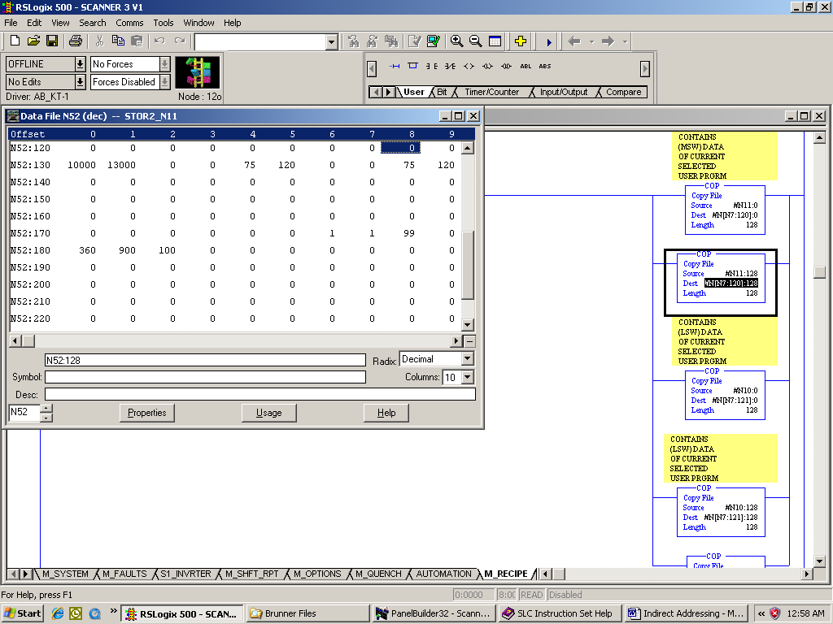

Slide 137
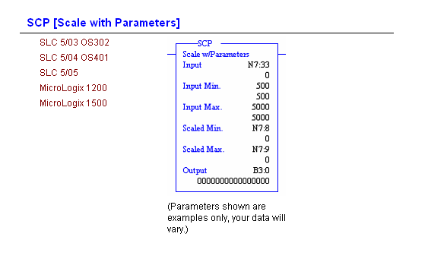
Scale with Parameters
Description
This output instruction consists of six parameters. Parameters may be integer, long, floating point (Floating point is only supported in the SLC 5/03, 5/04, and 5/05; not in the MicroLogix 1200 and 1500 processors.), or immediate data values or addresses containing values. The Input value is scaled to a range determined by creating a linear relationship between input min and max values and scaled min and max values. The scaled result is returned to the address indicated by the output parameter.
You can use indexed addressing (with SLC only) or indirect addressing.
Data filetypes MG (message) and PID are available to indirectly address parameters when using the MicroLogix 1200 or 1500 controller.

Slide 138
Entering Parameters
Entering Parameters
Input - Enter a value to be scaled. This can be a word address or an address of floating point data elements.
Input Min - Enter a minimum value for the input (low end of range). This value can be a word address, a long (double-word) address, an integer constant, floating point data element, or a floating point constant.
Input Max - Enter a maximum value for the input (high end of range). This value can be a word address, a long (double-word) address, an integer constant, floating point data element, or a floating point constant.
Scaled Min - Enter a minimum scaling value representing the low end of the range to which you want to scale the input. The scaling relationship is linear. The value can be a word address, a long (double-word) address, an integer constant, floating point data element, or a floating point constant.
Scaled Max - Enter a maximum scaling value representing the high end of the range to which you want to scale the input. The scaling relationship is linear. The value can be a word address, a long (double-word) address, an integer constant, floating point data element, or a floating point constant.
Output - Enter an address for the scaled value that is returned after the instruction is executed. This value can be a word address, a long (double-word) address or an address of floating point data elements. If any floating-point file types or floating-point constants are encountered in the above parameters, then the entire instruction is treated as floating point, and all immediate integer data values are converted to immediate floating-point data values.
Note The input minimum, input maximum, scaled minimum, and scaled maximum are used to determine the slope and offset values. The input value can go outside of the specified input limits and no ordering is required. For example, the scaled output value will not necessarily be clamped between the scaled minimum and scaled maximum values.

Slide 139
Value Checking
Value Checking
An invalid floating-point input value returns Not a Number and the overflow bit is set.
If the scaled output min is equal to the scaled output max, the scaled output is forced to the scaled output min.
If the input, input min, and input max are all equal, the output is forced to the scaled output min value.
If the input min is greater than the input max, the controller will scale the values with a negative slope.
If the scaled min is greater than the scaled max, the controller will scale the values with a negative slope.

Slide 140
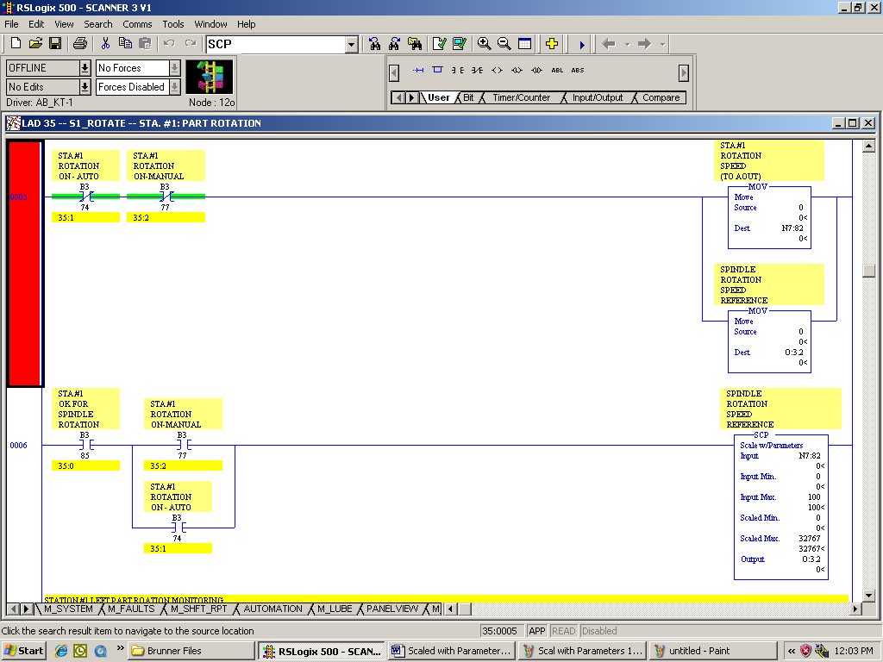

Slide 141
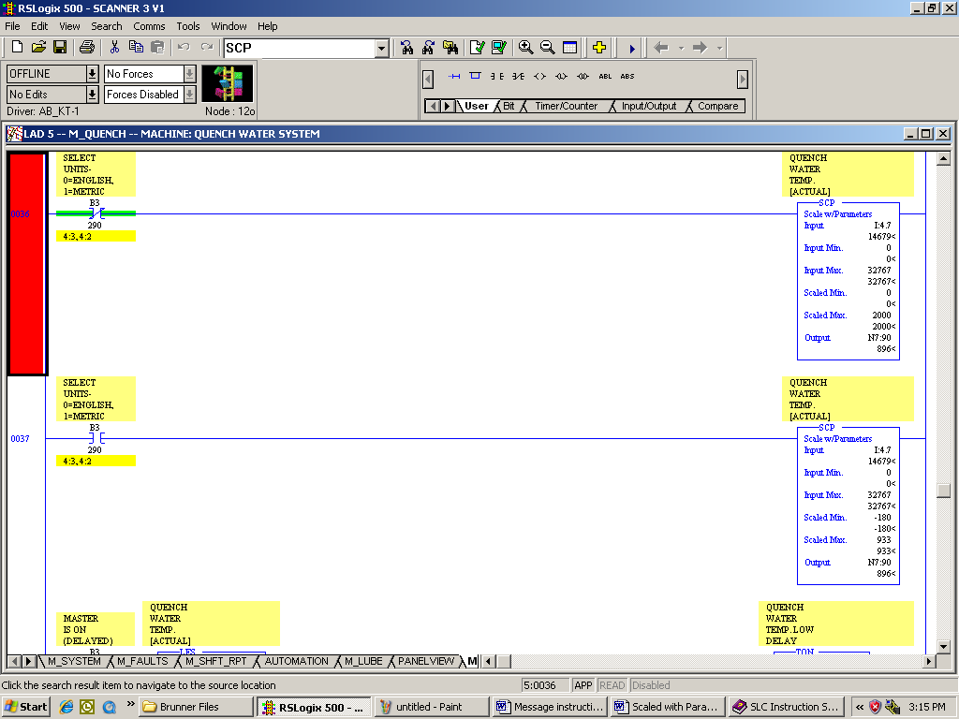

Slide 142
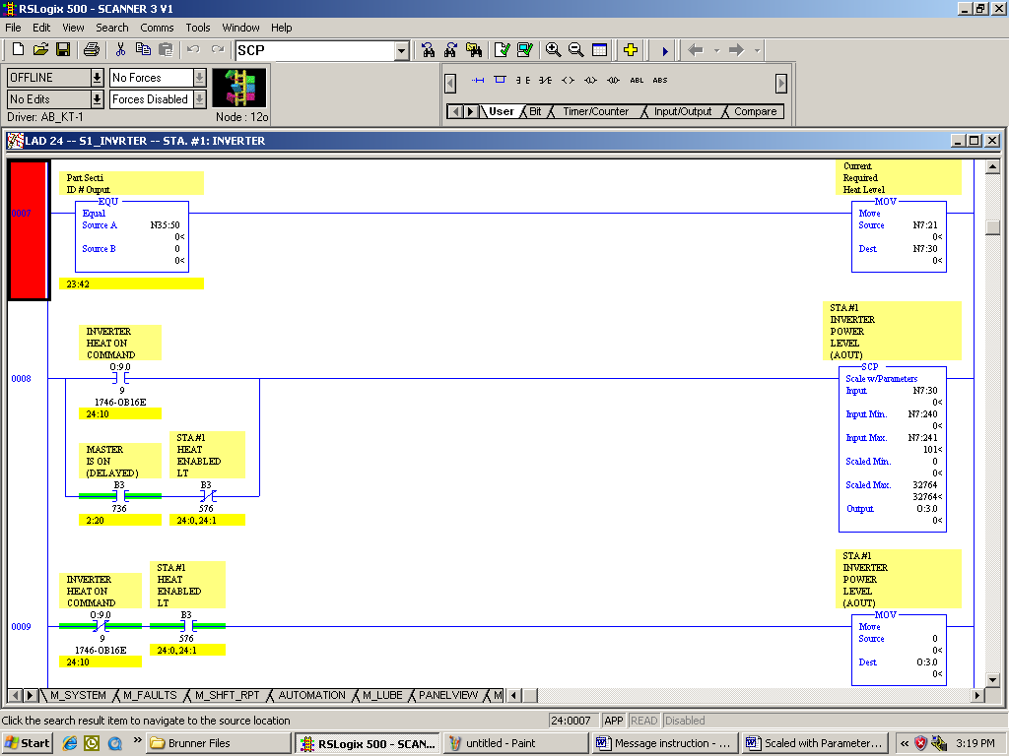

Slide 143
Troubleshooting
Test bits – why to use with latch & unlatch bits
Math overflow by disabling LAD files
Slow station logic using FIFO
Page titles or advance diag.
Use of histogram to look for bouncing input
Mapping fault alarm from Panelview to SLC File

Slide 144
LAB 10 - UPLOADING
Back to Brunner for File Uploading

Slide 145
End of Course

